Slide 1
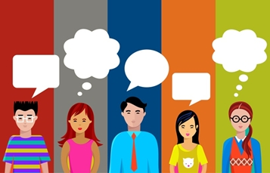
accent say words in a way that a certain group of people say the words

Slide 2
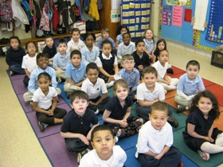
behave when a person follows the rules

Slide 3
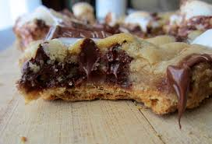
gooey something sticky

Slide 4
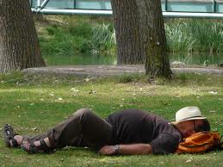
siesta an afternoon nap

Slide 5
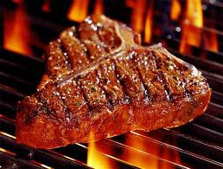
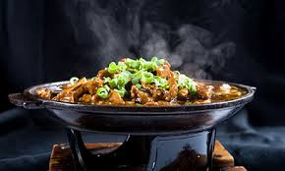
sizzling something that is very vey hot

Slide 6
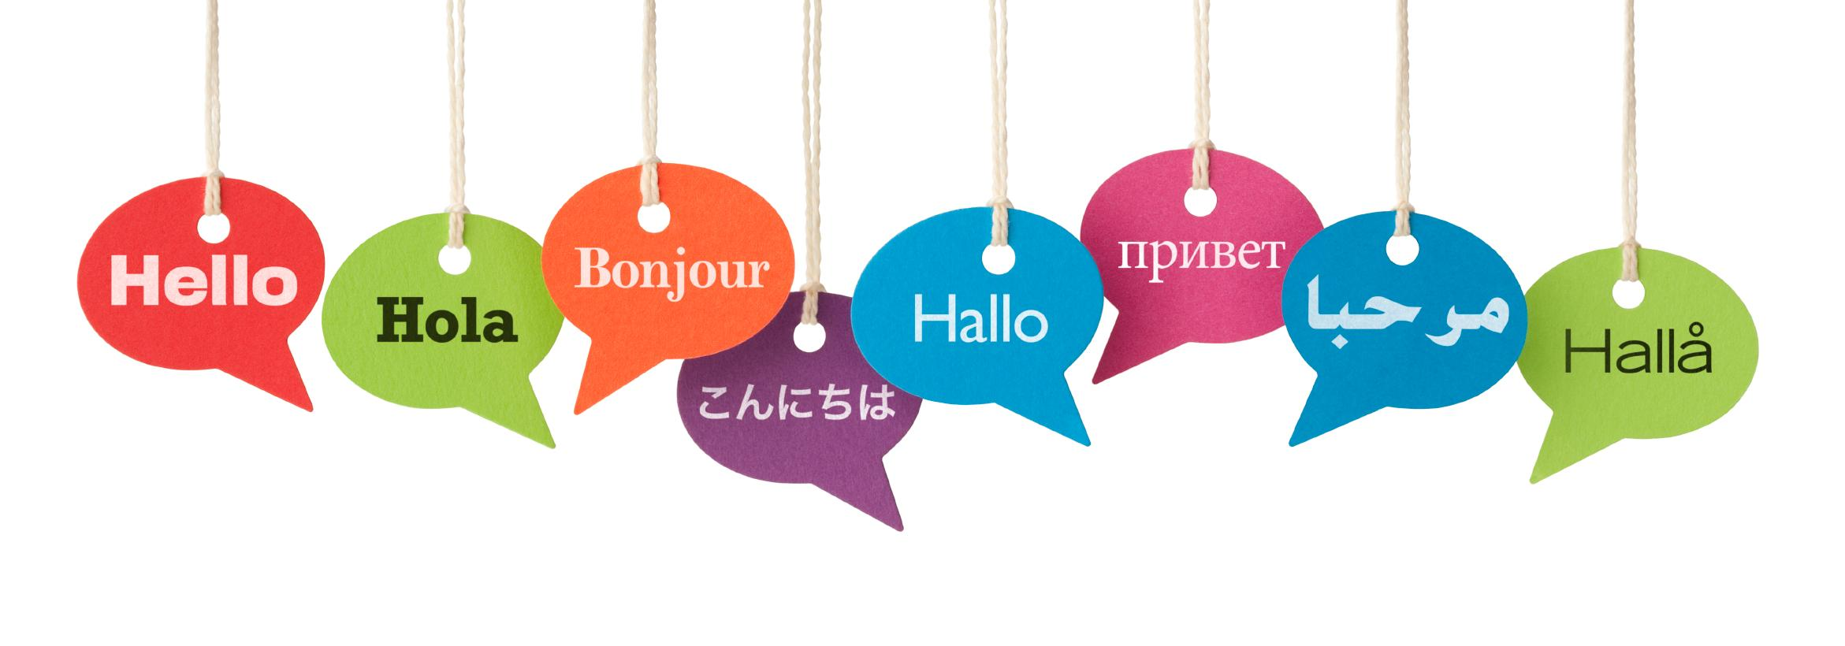
translated someone puts words into another language

