Slide 1
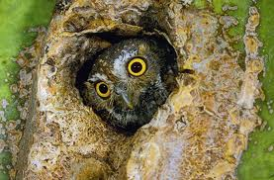
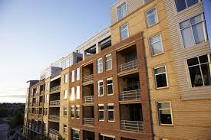
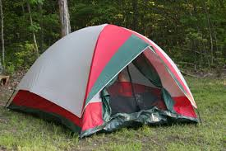
shelter a place that covers or protects you

Slide 2
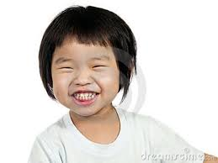
delighted when something pleases you or makes you happy

Slide 3
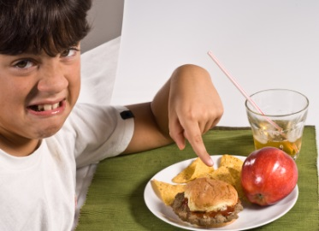
complain to tell about something that you do not like

Slide 4
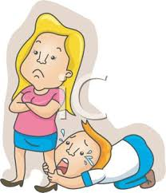
pleaded someone begged or asked for something that they really wanted

Slide 5
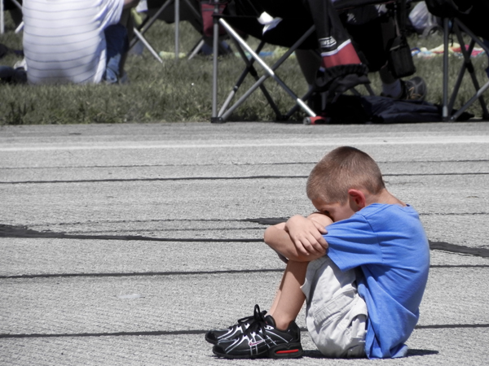
lonely to feel sad from being alone

Slide 6
horizon the line in the distance where the sky meets the ground

