Slide 1
Des Moines Public Schools AmeriCorps Orientation
September 5, 2013

Slide 2
Agenda
The Iowa Common Core Standards
2013-2014 Literacy Curriculum Guides
Resources to Support Literacy Instruction
DMPS Website
Think Central
Effective Small Group Instruction
Using the Journeys Materials for Small Group Instruction

Slide 3
The Iowa CC Standards
The DMPS Curriculum Guides
The Journeys Materials
Effective Small Group Instruction

Slide 4
Overview of the Common Core Standards
http://elementaryliteracy.dmschools.org/icc-standards.html

Slide 5
Iowa’s Adoption of the Common Core Standards
The Common Core State Standards in Literacy and Mathematics were integrated into the Iowa Core by Iowa State Board of Education action in 2010.
All school districts and accredited nonpublic schools are required to fully implement the Iowa Core in grades 9-12 by July 1, 2012 and grades K-8 by the 2014-2015 school year.

Slide 6
Literacy Curriculum Guides
2013 – 2014

Slide 7
The Overview Page

Slide 8
How to use this curriculum guide…
The Iowa Core Standards and the learner objectives listed on this district curriculum guide articulate our English Language Arts curriculum. These guides articulate what students need to know and be able to do during each unit of study at each grade level.
The Journeys materials will be used as our primary tool to support instruction and enhance student’s mastery of the Iowa CC Standards.

Slide 9
Page 1

Slide 11
What does Pg. 1 provide?
5 lessons = 6 weeks of instruction
6 day weeks
1 week for extension and reteaching
Big Idea and Essential Questions
Skill and Concepts for instruction
Being a Writer Unit
Science / Social Studies and Health Concepts
One Stop Shop!

Slide 12
Page 2

Slide 14
What Do You Use to Teach Pg. 2?
Journeys!
Whole Group Tab
Read Aloud
Introduce Comprehension
Main Selection
Deepening Comprehension
Small Group Tab
Leveled Readers
Leveled Practice
Extending the Common Core Booklet (ECC)

Slide 15
A Look at the Journeys Materials
Main Selection
Introduce Comprehension (Projectable)

Slide 16
Literature
Vocabulary Readers
Leveled Readers
Grade Level Anthology and Student Magazine

Slide 17
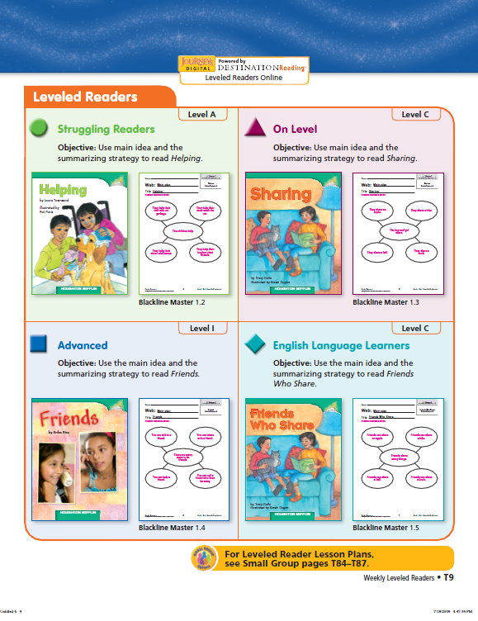
Weekly Leveled Readers

Slide 18
Page 3

Slide 20
What Do You Use to Teach Pg. 3?
Writing | Grammar
Being a Writer (Unit listed in italics at the top) **This is a separate set of materials than Journeys. | Journeys (Lesson listed in parentheses beside “I Can”)

Slide 21
Page 4

Slide 23
What Do You Use to Teach Pg. 4?
Journeys!
Whole Group Tab
Opening Routines: PA, Phonics, Sight Words
Phonemic Awareness Lessons (K)
Phonics Lessons
Fluency Lessons
Word Study Spiral

Slide 24
What Do You Use to Teach Pg. 4?
Speaking and Listening Standards:
Extending the Common Core (ECC)
Integrated into Comprehension and Writing
ECC

Slide 25
Resources to Support your Work

Slide 26
DMPS Literacy Website

Slide 27
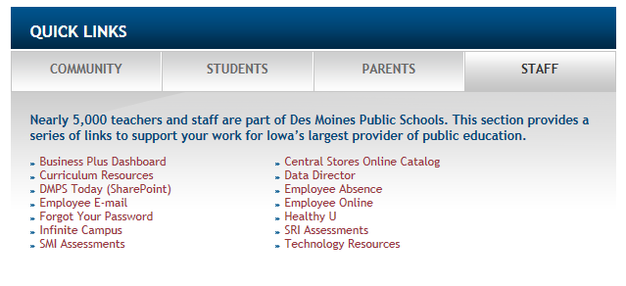
Accessing the Websites
www.dmschools.org

Slide 28
Accessing the Websites

Slide 29
Accessing the Websites
www.elementaryliteracy.dmschools.org
www.elementarymath.dmschools.org

Slide 30
Literacy Website
Curriculum Guides
Health, Social Studies, & Science Resources
Assessments
SHARED teacher-created resources (more, please!)
Video Lessons (coming soon…)

Slide 31
Think Central

Slide 32
What will you find on Think Central?
Teacher’s Manuals
Leveled Readers
With a Read Aloud Function
Can be Printed in Booklet Form
Practice Book
Projectables
Grab and Go
All Things Journeys…

Slide 33
Logging into Think Central
State: Iowa
District: Des Moines Public School Dist
School: Adams Elementary
User Name: americorps
Password: americorps
All hints: americorps

Slide 34
How do I get Help?
Help Support!

Slide 35
Resources
There are two places you can click to access Resources

Slide 36
Narrowing by Grade Level & Content Area

Slide 38
Click the printer icon to print this instructional page.
Click the “page” icon to access the table of contents (helpful when you’d like to skip right to a specific lesson)

Slide 40
When you select a level, the next page will provide you with a list of the titles by lesson.

Slide 41
You can play the audio of the leveled text by selecting the microphone.
** If your audio feature does not work, please be sure that you have the most updated version of flash player and that there is not a yellow bar at the top of the screen that requests you to “trust this site”.
You can print or save the leveled readers by using these icons.

Slide 44
** These are your “Words to Know”
Click on the “page icon” to see a list of all of the words. Click on a specific word and that card will come up.
Click on the printer icon the print the front or back of the card.

Slide 46
** These are your “Words to Know”
Click on the “page icon” to see each lesson listed by unit.
Click on the printer icon to print each page.

Slide 48
** These are your Phonics Word Sort Cards
Click on the “page icon” to see each lesson listed by unit.
Click on the printer icon to print each page.

Slide 51
Select “Save” for any pictures and then select “My Pictures for printing.

Slide 52
Break!
15 minutes

Slide 53
SMALL GROUP Instruction
The Basics
Notes:
Liz- 80-90 minutes

Slide 54
Advantages Small Groups
By flexibly grouping students based on their strengths and needs, teachers can tailor their teaching to provide specific instruction that best challenges the learners.
Teachers can slow down and focus on specifics.
Instruction is specific, materials are easily managed, conversation flows freely and student efforts are easily monitored.
Students receive support to expand conceptual understanding and improve their procedural fluency as instruction is differentiated.
“In the comfort and safety of a small group, students learn how to work with others, how to attend to shared information, and how to ask questions or ask for help.” Fountas and Pinell (2001)
Notes:
Students will receive whole group instruction with the teacher. Then work in small groups. This small group instruction is intended to support the same concepts and ideas that they worked on during the whole group instruction.
The groups will be based on reading level. There will be below level readers, on level readers, and above level readers. For the most part, you will work with the on level kids.
There is a lot of research on the benefits of working with small groups:
(2 minutes)

Slide 55
Small Group Examples
3rd Grade Video
Post-It Note
2-3 teacher actions that supported student learning.
3rd Grade
Notes:
Video = 8 min, Explaining time= 1 min, Sharing time = 1 min = (10 minutes)
Share one thing with a partner from your post-it

Slide 56
Strategies for Small Group Learning
Handout and Activity
Notes:
I want to give you a chance to read through and practice with some research-based small group strategies.

Slide 57
Small Group Strategies
5 Notecards
#1: Background Info.
#2: Teaching Vocabulary in Action
#3: Rating Vocabulary Knowledge
#4: Language Prompts
#5: Idea Wave
*Consider bringing your strategy cards to support your small group instruction in the classroom!
Notes:
Read the handout at your table and grab 5 notecards. While reading, make some notes on each card.
(10-15 min)

Slide 58
Small Group Strategies
Turn to a partner.
Read one of the Leveled Readers at your table together, taking turns reading aloud.
Set the lesson plan aside. Pick a strategy from your notecards to model for your partner while you read together. You will be the small group leader. Your partner will act as a student.
Switch roles and repeat. Model a new strategy if possible.

Slide 59
Small Group Examples
5th Grade Video
Post-It Note
2-3 teacher actions that supported student learning.
5th Grade
Notes:
7 minutes, 1 minute for sharing = 8 minutes
Share one thing with a partner from your post-it

Slide 60
Journeys Materials
Small Group Instruction

Slide 61
Small Group
**From Designing the Instructional Day**
DAY 1- Vocabulary Reader or Reteaching Previous Week
DAY 2- Leveled Reader (Journeys Day 3)
DAY 3- Leveled Reader (Continued if needed)
DAY 4- Leveled Practice (Journeys Day 2)
DAY 5- Decodable Reader (K-2), Reteaching

Slide 62
Small Group
**From Designing the Instructional Day**
DAY 1- Vocabulary Reader or Reteaching Previous Week
DAY 2- Leveled Reader (Journeys Day 3)
DAY 3- Leveled Reader (Continued if needed)
DAY 4- Leveled Practice (Journeys Day 2)
DAY 5- Decodable Reader (K-2), Reteaching

Slide 63
DAY 1: Vocabulary Reader
“Vocabulary Reader” = Day 1 (Small Group Tab) in Journeys Materials
Notes:
Very explicit teaching plan in teacher’s manual
You can access online!

Slide 64
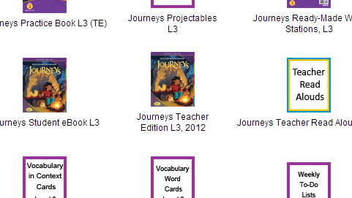
ThinkCentral.com
Reading/Language Arts → Journeys
Log In
Click “Resources”
Choose “Reading” and “Grade 3” and SEARCH
Find “Journeys Teacher Edition L3, 2012”

Slide 65
Logging into Think Central
State: Iowa
District: Des Moines Public School Dist
School: Adams Elementary
User Name: americorps
Password: americorps
All hints: americorps

Slide 66
DAY 1: Vocabulary Reader
“Vocabulary Reader” = Day 1 (Small Group Tab) in Journeys Materials (Page T74 in TE)

Slide 67
Small Group
**From Designing the Instructional Day**
DAY 1- Vocabulary Reader or Reteaching Previous Week
DAY 2- Leveled Reader (Journeys Day 3)
DAY 3- Leveled Reader (Continued if needed)
DAY 4- Leveled Practice (Journeys Day 2)
DAY 5- Decodable Reader (K-2), Reteaching

Slide 68
DAY 1: Reteaching
“Options for Reteaching” = Day 5 (Small Group Tab) in Journeys Materials (Page T86 in TE)

Slide 69
Small Group
**From Designing the Instructional Day**
DAY 1- Vocabulary Reader or Reteaching Previous Week
DAY 2- Leveled Reader (Journeys Day 3)
DAY 3- Leveled Reader (Continued if needed)
DAY 4- Leveled Practice (Journeys Day 2)
DAY 5- Decodable Reader (K-2), Reteaching

Slide 70
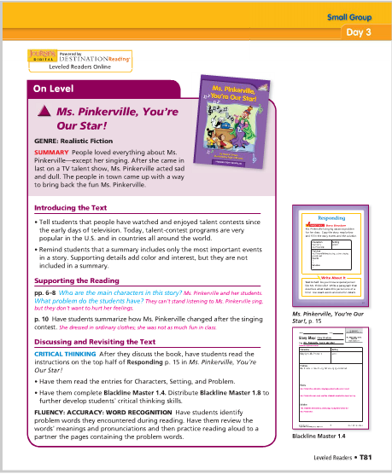
DAY 2-3: Leveled Reader
“Leveled Readers” = Day 3 (Small Group Tab) in Journeys Materials (Page T81 in TE AND 8 page Lesson Plan!)

Slide 71
DAY 2-3: Leveled Reader
Accessing the Leveled Reader Teacher Guide:
*handout*

Slide 72
Small Group
**From Designing the Instructional Day**
DAY 1- Vocabulary Reader or Reteaching Previous Week
DAY 2- Leveled Reader (Journeys Day 3)
DAY 3- Leveled Reader (Continued if needed)
DAY 4- Leveled Practice (Journeys Day 2)
DAY 5- Decodable Reader (K-2), Reteaching

Slide 73
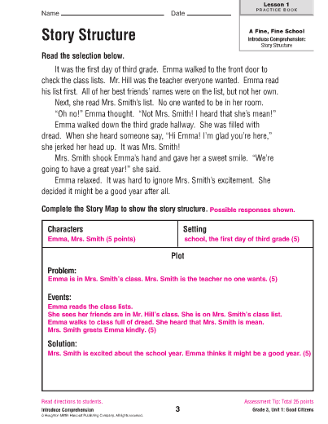
DAY 4: Leveled Practice
“Practice Book” (On Level) Day 2 (Small Group Tab) in Journeys Materials
(Practice Book, Pg. 3)

Slide 74
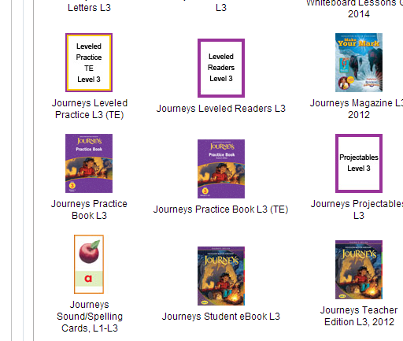
DAY 4: Leveled Practice
“Practice Book” (On Level) = Day 3

Slide 75
Small Group
**From Designing the Instructional Day**
DAY 1- Vocabulary Reader or Reteaching Previous Week
DAY 2- Leveled Reader (Journeys Day 3)
DAY 3- Leveled Reader (Continued if needed)
DAY 4- Leveled Practice (Journeys Day 2)
DAY 5- Decodable Reader (K-2), Reteaching

Slide 76
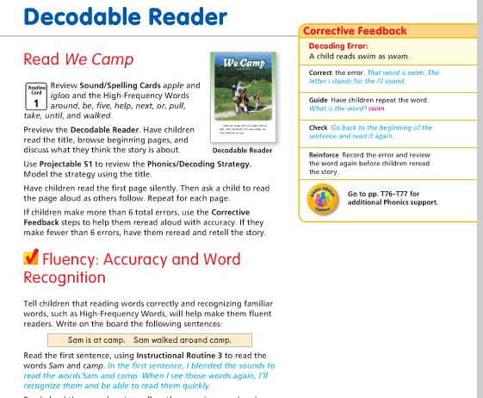
DAY 5: Decodable Reader (K-2)
“Decodable Reader” = Day 1 (Whole Group Tab) in Journeys Materials
2nd Grade
Unit 1- Page T21

Slide 77
Small Group
**From Designing the Instructional Day**
DAY 1- Vocabulary Reader or Reteaching Previous Week
DAY 2- Leveled Reader (Journeys Day 3)
DAY 3- Leveler Reader (Continued if needed)
DAY 4- Leveler Practice (Journeys Day 2)
DAY 5-Decodable Reader (K-2), Reteaching

Slide 78
DAY 5: Reteaching
“Options for Reteaching” = Day 5 (Small Group Tab) in Journeys Materials (Page T86 in TE)
**Same slide as Day 1!
Notes:
30 min

Slide 79
Leveled Readers Practice
*Days 2-3*
Grab a Leveled Reader
Use the lesson plan to prepare a lesson. Consider incorporating the strategies from your notecards.
Teach this lesson to your partner.

Slide 80
Small Group Examples
Post-It Note
2-3 teacher actions that supported student learning.
1st Grade Video
1st Grade
Notes:
5 min + 1 min sharing = 6 min
Share one thing with a partner from your post-it

Slide 81
Questions?
Take a few minutes to explore ThinkCentral.com

Slide 82
Lunch
1 hour

Slide 83
Elementary Math 2013 – 2014 AmeriCorps
September 5. 2013

Slide 84
Elementary Math in DMPS
39 Elementary Schools
All Kindergarten and First Grade classrooms use “Investigations” instructional materials.
Grades 2 – 5
33 of our elementary schools use “Expressions” instructional materials.
Grade 2 – 5
6 of our elementary schools use “Investigations” instructional materials.
(Oak Park, Morris, South Union, Downtown, Jefferson and Samuelson)
*2013 – 2014 DMPS is going through the instructional materials upgrade process.

Slide 85
Elementary Math in DMPS
Assessments
Kindergarten | Grade 1 | Grade 2 | Grade 3 | Grade 4 | Grade 5
Trimester 1 | Trimester 1 | Unit 1 | Unit 1 | Unit 1 | Unit 1
 |  | Unit 2 |  | Unit 2
Trimester 2 | Trimester 2 | Unit 3 | Unit 2 | Unit 3 | Unit 2
 |  | Unit 4 | Unit 3 | Unit 4 | Unit 3
Trimester 3 | Trimester 3 | Unit 5 | Unit 4 | Unit 5 | Unit 4
 |  | Unit 6 | Unit 5 | Unit 6 | Unit 5
PRE-ASSESSMENT
Prior, On, Above
POST-ASSESSMENT
Mastery
Notes:
How does this all fit together?
Teachers will use the data teams process around pre- and post-test data to inform instructional planning.
A reminder that all DMPS math classrooms will include:
Daily Math Review + Mental Math
Whole group + small group instruction
Fact Fluency
Formative Assessment
In an approximate 60 – 90 minute math block.

Slide 86
Elementary Math in DMPS
PRE-ASSESSMENT
Prior, On, Above
POST-ASSESSMENT
Mastery
Teachers will use the Data Teams process around pre- and post-test data to inform instructional planning.
Classrooms will include:
Daily Math Review
Mental Math
Whole Group Instruction
Small Group Instruction
Fact Fluency
Formative Assessment
75 – 90 Minutes
(Approximate)
Notes:
How does this all fit together?
Teachers will use the data teams process around pre- and post-test data to inform instructional planning.
A reminder that all DMPS math classrooms will include:
Daily Math Review + Mental Math
Whole group + small group instruction
Fact Fluency
Formative Assessment
In an approximate 60 – 90 minute math block.

Slide 87
Elementary Math in DMPS
PRE-ASSESSMENT
Prior, On, Above
POST-ASSESSMENT
Mastery
Your Role:
Work with teacher to identify the small group you will be working with in between the pre-assessment and post-assessment (should be the on-grade level group).
Work with the teacher to analyze the student work and identify their strengths, as well as, areas of challenge.
Begin to plan small group lessons around their areas of need.
Notes:
How does this all fit together?
Teachers will use the data teams process around pre- and post-test data to inform instructional planning.
A reminder that all DMPS math classrooms will include:
Daily Math Review + Mental Math
Whole group + small group instruction
Fact Fluency
Formative Assessment
In an approximate 60 – 90 minute math block.

Slide 88
Elementary Math in DMPS
Your Role:
Work with teacher to identify the small group you will be working with in between the pre-assessment and post-assessment (should be the on-grade level group).
Work with the teacher to analyze the student work and identify their strengths, as well as, areas of challenge.
Begin to plan small group lessons around their areas of challenge.
THREE MINUTE REFLECTION
What challenges do you foresee in this process? What can you do to overcome these challenges?
Notes:
How does this all fit together?
Teachers will use the data teams process around pre- and post-test data to inform instructional planning.
A reminder that all DMPS math classrooms will include:
Daily Math Review + Mental Math
Whole group + small group instruction
Fact Fluency
Formative Assessment
In an approximate 60 – 90 minute math block.

Slide 89
Resources and Support
Notes:
This was a very quick overview of the guides, but we wanted to allow you time to review your grade level, unit one guides.
The unit one guides are also available on the math website.
(5 – 10 minutes)

Slide 90
Resources and Support
The Curriculum Guide
Standards
Learner Objectives
Prerequisite and Looking Ahead Skills
Deeper look into the Content Standards
Examples of Content Standards
Hyperlinks to resources
Deeper look into the Mathematical Practice Standards
Notes:
How does this all fit together?
Teachers will use the data teams process around pre- and post-test data to inform instructional planning.
A reminder that all DMPS math classrooms will include:
Daily Math Review + Mental Math
Whole group + small group instruction
Fact Fluency
Formative Assessment
In an approximate 60 – 90 minute math block.

Slide 91
Resources and Support
Units + Guides
Kindergarten | Grade 1 | Grade 2 | Grade 3 | Grade 4 | Grade 5
Trimester 1 | Trimester 1 | Unit 1 | Unit 1 | Unit 1 | Unit 1
 |  | Unit 2 |  | Unit 2
Trimester 2 | Trimester 2 | Unit 3 | Unit 2 | Unit 3 | Unit 2
 |  | Unit 4 | Unit 3 | Unit 4 | Unit 3
Trimester 3 | Trimester 3 | Unit 5 | Unit 4 | Unit 5 | Unit 4
 |  | Unit 6 | Unit 5 | Unit 6 | Unit 5
Notes:
How does this all fit together?
Teachers will use the data teams process around pre- and post-test data to inform instructional planning.
A reminder that all DMPS math classrooms will include:
Daily Math Review + Mental Math
Whole group + small group instruction
Fact Fluency
Formative Assessment
In an approximate 60 – 90 minute math block.

Slide 92
Resources and Support
Notes:
How does this all fit together?
Teachers will use the data teams process around pre- and post-test data to inform instructional planning.
A reminder that all DMPS math classrooms will include:
Daily Math Review + Mental Math
Whole group + small group instruction
Fact Fluency
Formative Assessment
In an approximate 60 – 90 minute math block.

Slide 93
Resources and Support
Notes:
How does this all fit together?
Teachers will use the data teams process around pre- and post-test data to inform instructional planning.
A reminder that all DMPS math classrooms will include:
Daily Math Review + Mental Math
Whole group + small group instruction
Fact Fluency
Formative Assessment
In an approximate 60 – 90 minute math block.

Slide 94
Resources and Support
Notes:
How does this all fit together?
Teachers will use the data teams process around pre- and post-test data to inform instructional planning.
A reminder that all DMPS math classrooms will include:
Daily Math Review + Mental Math
Whole group + small group instruction
Fact Fluency
Formative Assessment
In an approximate 60 – 90 minute math block.

Slide 95
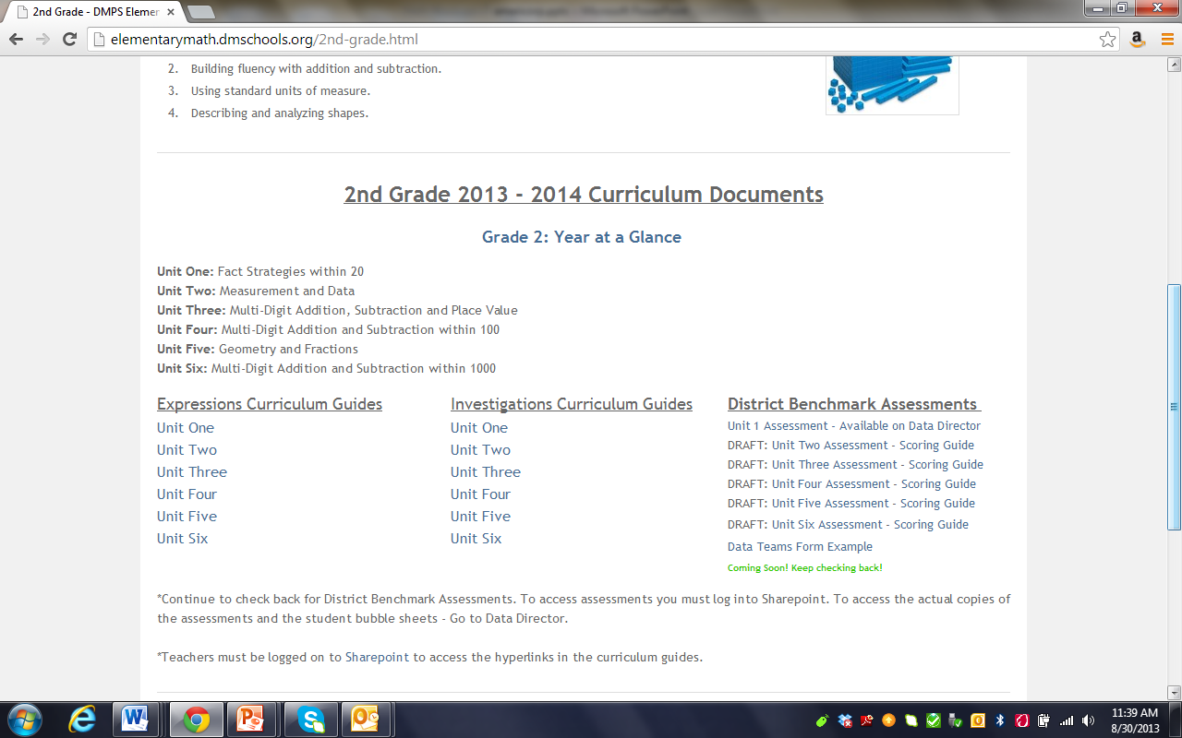
Resources and Support
Notes:
How does this all fit together?
Teachers will use the data teams process around pre- and post-test data to inform instructional planning.
A reminder that all DMPS math classrooms will include:
Daily Math Review + Mental Math
Whole group + small group instruction
Fact Fluency
Formative Assessment
In an approximate 60 – 90 minute math block.

Slide 96
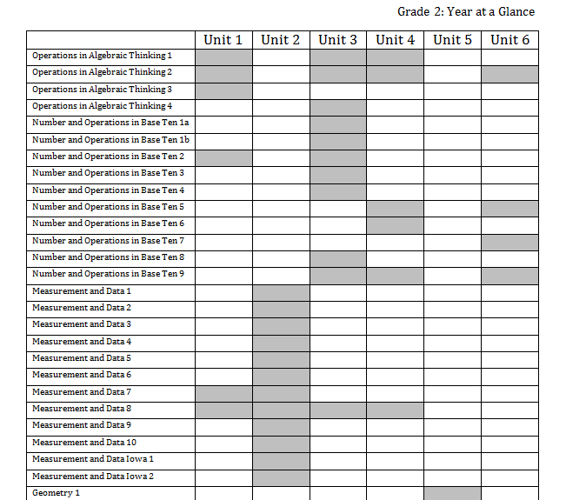
Resources and Support
Notes:
How does this all fit together?
Teachers will use the data teams process around pre- and post-test data to inform instructional planning.
A reminder that all DMPS math classrooms will include:
Daily Math Review + Mental Math
Whole group + small group instruction
Fact Fluency
Formative Assessment
In an approximate 60 – 90 minute math block.

Slide 97
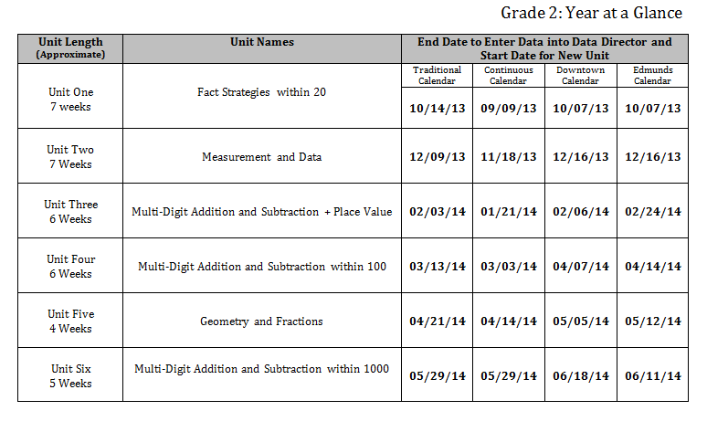
Resources and Support
Notes:
How does this all fit together?
Teachers will use the data teams process around pre- and post-test data to inform instructional planning.
A reminder that all DMPS math classrooms will include:
Daily Math Review + Mental Math
Whole group + small group instruction
Fact Fluency
Formative Assessment
In an approximate 60 – 90 minute math block.

Slide 98
Resources and Support
Notes:
How does this all fit together?
Teachers will use the data teams process around pre- and post-test data to inform instructional planning.
A reminder that all DMPS math classrooms will include:
Daily Math Review + Mental Math
Whole group + small group instruction
Fact Fluency
Formative Assessment
In an approximate 60 – 90 minute math block.

Slide 99
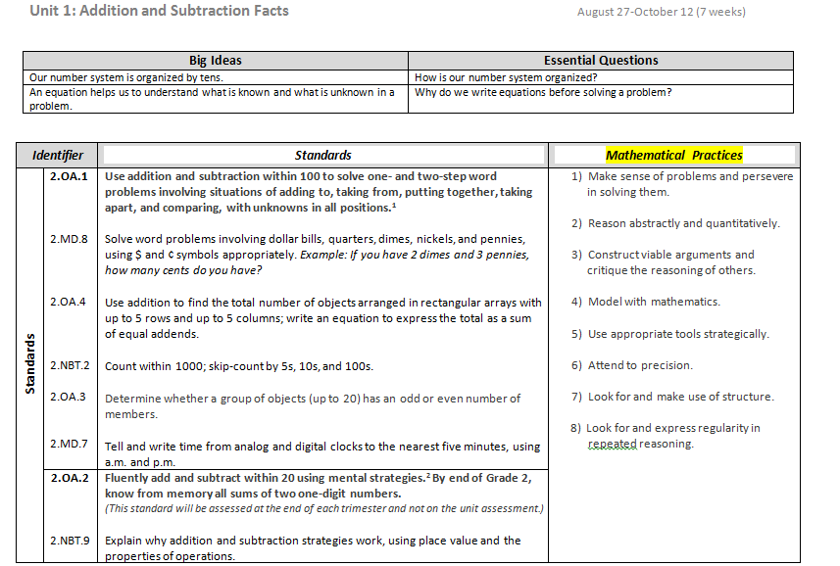
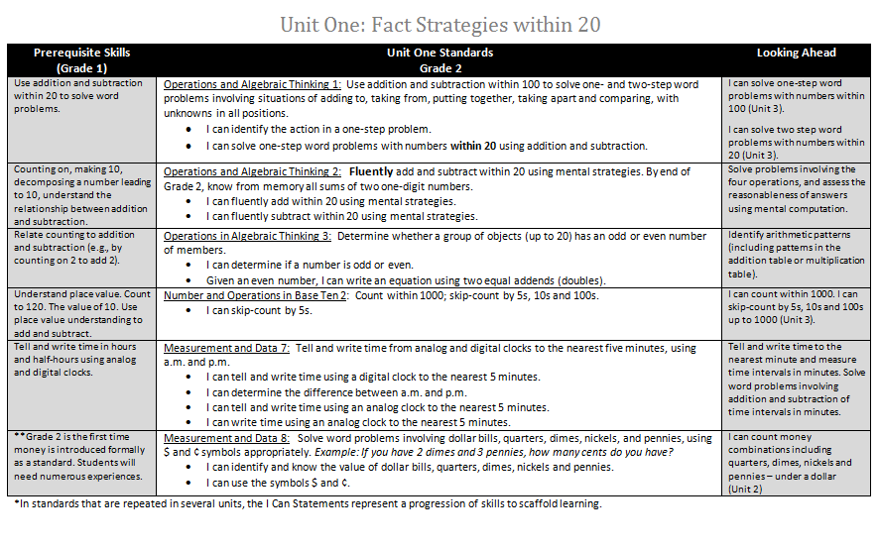
Math Data Teams Model
Standard
I Can Statements
Deepen Teacher/Americorps Content Knowledge
Student Friendly Language
Prerequisite Skills
Daily Math Review
Mental Math
Small Group Work
Intervention
Coherence Across Grade Levels
Looking Ahead
Small Group Work
Enrichment
Coherence Across Grade Levels
Notes:
At the beginning of each unit you will have a page that looks like this…
(Click) In the past we have labeled the standards like 2.0A.1 – you will notice now that we have written out the Standard name.
(Click) – Then you will see the standard as written in the common core.
(Click) – And underneath you will find the ‘I Can’ statements.
(Click) You will also notice on the left hand side the Pre-requisite skills for that standard. Feedback from teachers was that it was hard to know what the students learned the year before in order to create a baseline for learning the new skill. It also allows the teacher to use these skills in Daily Math Review in order to review before teaching the core skill in whole group.
(Click) On the right hand side you will see the Look Ahead – which will look to future units and/or grade levels in order to provide extensions for those students who may be accelerating.

Slide 100
Standard Progressions
Solve word problems involving dollar bills, quarters, dimes, nickels, and pennies, using $ and ¢ symbols appropriately. Example: If you have 2 dimes and 3 pennies, how many cents do you have?
Unit One
Unit Two
Unit Three
Unit Four
Notes:
An example of this is Measurement and Data 8 or 2.MD.8
The standard reads: Solve word problems involving dollar bills, quarters, dimes, nickels, and pennies, using $ and ¢ symbols appropriately. Example: If you have 2 dimes and 3 pennies, how many cents do you have?
In our current guides we see this standard, written and assessed like this, in units 1, 2, 3, and 4.
In the revised guides we have created standard progressions.
Unit One – Measurement and Data 8:
I can identify and know the value of dollar bills, quarters, dimes, nickels and pennies.
I can use the symbols.
2nd grade is the first time students have experience with money so it would be difficult in unit one for students to be able to solve word problems using money.
So we started them off with identifying coins.
Then in Unit Two – Measurement and Data 8:
I can count money combinations including quarters, dimes, nickels and pennies under a dollar.
The in Unit Three is the same but over a dollar.
And finally, Unit 4 would be solving word problems involving….
This will make the standards more manageable within a unit.
You will also notice that the prerequisite skills identify what have been done in past units and then Look Aheads for future units.

Slide 101
Think – Pair – Share
THINK
2 ways you could use this in your role.
PAIR
With an elbow partner.
SHARE
Your thinking.

Slide 102
Math Data Teams Model
Notes:
So we have talked about the first page(s) in each unit.
Now – Let’s talk about the following pages in each unit.
(Click) We are going to focus on Number and Operations in Base Ten 2
(Click) We are only in Unit One therefore we are breaking the standard down to skip count by only 5’s.

Slide 103
Math Data Teams Model
What does this standard mean the students will know and be able to do?
Deepen Math Content Knowledge
Mini-PD sessions for coaches + teachers
2013 – 2014 PD Plan
Strategies
Examples
Practice
Collaboration
Notes:
Each standard on the first page – has it’s own page.
So Number and Operations in Base Ten 2 has its own page.
Its listed the standard on the top left (click) and the learner objective on the top right (click).
(Click) The next section explains more in depth what the standard means the students will know and be able to do.
It also provides some examples of the standard (Click).
Both the explanation and the examples will help to (click) deepen teacher content knowledge.
The next section (click) are lessons and resources for that particular standard.
We heard from teachers that it was difficult to pull from so many different resources when planning instruction.
We have tried to streamline that process by locating the resources for each standard in one place.
You will see that many resources (that are not found in the textbook) are hyperlinked.
(Click)
So if you were to click on “Number Line” – it will open the resource (CLICK – to next slide).

Slide 104
Math Data Teams Model
Hyperlinks
Lessons and Resources for Base Ten 2
Notes:
Each standard on the first page – has it’s own page.
So Number and Operations in Base Ten 2 has its own page.
Its listed the standard on the top left (click) and the learner objective on the top right (click).
(Click) The next section explains more in depth what the standard means the students will know and be able to do.
It also provides some examples of the standard (Click).
Both the explanation and the examples will help to (click) deepen teacher content knowledge.
The next section (click) are lessons and resources for that particular standard.
We heard from teachers that it was difficult to pull from so many different resources when planning instruction.
We have tried to streamline that process by locating the resources for each standard in one place.
You will see that many resources (that are not found in the textbook) are hyperlinked.
(Click)
So if you were to click on “Number Line” – it will open the resource (CLICK – to next slide).

Slide 105
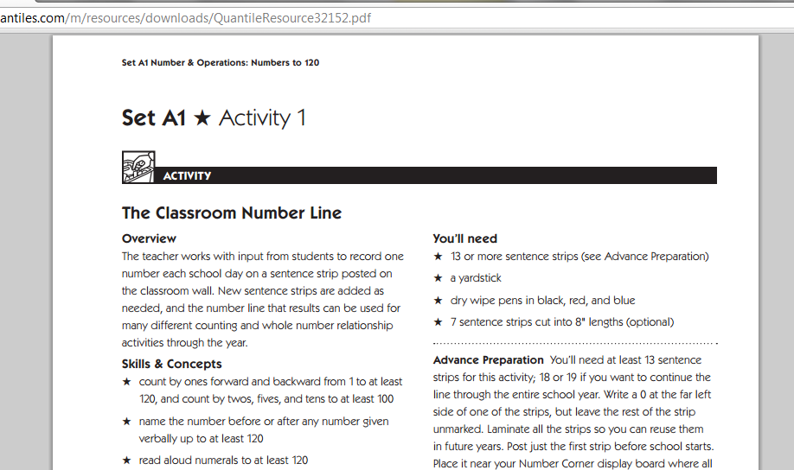
Linked to Sharepoint – Teachers will need to sign in using their DMPS username and password.
Notes:
Example – Number Line Hyperlink

Slide 106
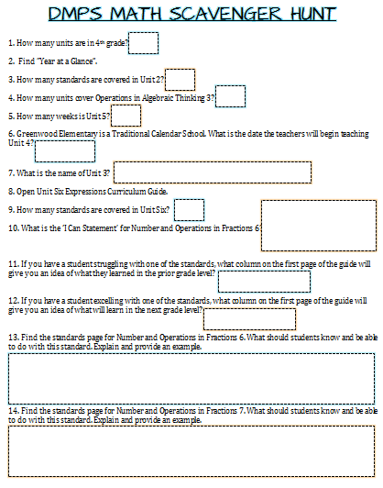
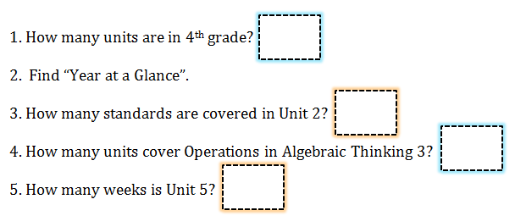
SCAVENGER HUNT
CHECK YOUR ANSWERS WITH A PARTNER!
Notes:
This was a very quick overview of the guides, but we wanted to allow you time to review your grade level, unit one guides.
The unit one guides are also available on the math website.
(5 – 10 minutes)

Slide 107
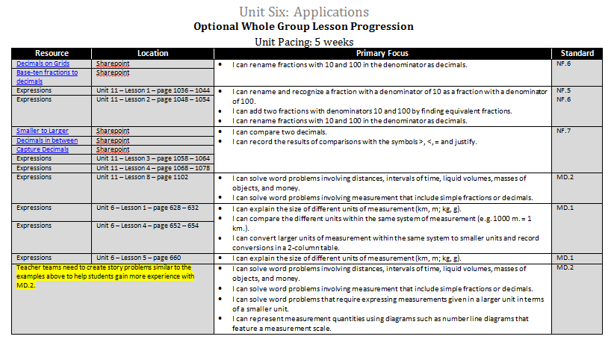
Notes:
That being said – at the end of every unit in an optional lesson progression. This will help teachers understand how to “teach it all”.
You will see on the left the resource and the location. Then the primary focus and the standard of the lesson.

Slide 108
Notes:
That being said – at the end of every unit in an optional lesson progression. This will help teachers understand how to “teach it all”.
You will see on the left the resource and the location. Then the primary focus and the standard of the lesson.

Slide 109
Notes:
That being said – at the end of every unit in an optional lesson progression. This will help teachers understand how to “teach it all”.
You will see on the left the resource and the location. Then the primary focus and the standard of the lesson.

Slide 110
Notes:
That being said – at the end of every unit in an optional lesson progression. This will help teachers understand how to “teach it all”.
You will see on the left the resource and the location. Then the primary focus and the standard of the lesson.

Slide 111
CONTINUE SCAVENGER HUNT
Notes:
This was a very quick overview of the guides, but we wanted to allow you time to review your grade level, unit one guides.
The unit one guides are also available on the math website.
(5 – 10 minutes)

Slide 112
Math Data Teams Model
Emphasized Standards for Mathematical Practice
Hyperlinks
Notes:
The last section is the Emphasized Standards for Mathematical Practice which is the how behind learning math.
But we heard from you that you wanted these standards specific to your grade level.
So again, if you click them – you will see they are hyperlinked. The link will take you to our website which will give you more information on how implement this practice standard in your grade level. Click to next slide – example.

Slide 113
Mathematical Practice Standards
Located on the Math Website
Specific by Grade Level
Focus of 2013 – 2014 PD
Strategies
Examples
Notes:
Example of Mathematical Practice Standard Hyperlink.

