Slide 1
5th Grade Writing Assessment
Pretest September 2013
Posttest May 2014

Slide 2
5th Grade Persuasive Writing
What is Persuasive Writing?
Persuasive writing intends to influence how someone thinks, feels, acts, and makes decisions in relation to a particular issue or idea.

Slide 3
Day 1 Directions (read aloud to students)
You will have two days to complete your writing. Today, I’m going to go over the prompts that you can choose to write about.
I’m also going to clarify the expectations I will expect from your writing and give you time to THINK about what you want to write about.
Today, you’ll have 20 minutes to write. I’ll collect your papers and tomorrow you will have 30 minutes to finish your writing.

Slide 4
Prompt #1
Your principal wants to put a stop to bullying in your school. Write an essay or letter to your principal explaining what changes you think need to be made to help your school become “bully free.”

Slide 5
Prompt #1 Continued
Give examples with details that will persuade him/her to choose your suggestions.
You must give reasons to support the changes you suggest.
Your write needs to start with an introductory statement that states your opinion and persuades the reader to think the way you do.
Remember to end with a concluding statement.

Slide 6
Prompt #2
Most elementary schools have a policy against using cell phones at school. Some students think cell phones should be allowed in the classroom.
Write an essay or letter to the teachers in your school to convince them to let students have and use cell phones during the school day.

Slide 7
Prompt #2 Continued
Your writing needs to start with an introductory statement that states your opinion and persuade your readers to think the way you do.
Remember to end
with a concluding
statement.

Slide 8
SO…
What prompt will you choose to write about??
A persuasive piece about stopping bullying at school…
OR
A persuasive piece about being able to use cell phones at school?

Slide 9
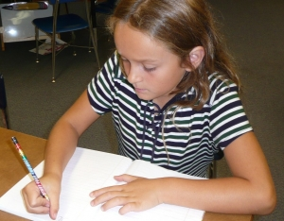
Day 2 Directions (read aloud to students)
Yesterday you began your writing assignment. Today, you will have another 30 minutes to reread your writing to make any necessary revisions and complete your piece.
I will tell you when there are 5 minutes left to finish. At that time you should finish writing and reread what you have written to make any changes you think will improve your writing.

