Slide 1
Teaching and Learning Elementary
2.25.14
Dean Avenue Conference Center

Slide 2
Today’s Agenda
Time Frame | Agenda Item | Area of Focus | Presenter
8:30-8:35am | Welcome and Overview of Agenda |  | Carlyn Cox
8:35-9:20am | Iowa Assessment | Data-Driven Decision Making | Cindy Slinger
9:20-9:30am | Celebrations & Updates | Data-Driven Decision Making | Carlyn Cox
9:30-10:00am | Go Math Framework for Teaching | Effective Instructional Practices | Anna Taggart
10:00 -10:30am | Go Math Chapter One + Guide | Effective Instructional Practices | J. Starr
10:30-10:45am | Break
10:45-11:40am | Supporting Implementation | Collaborative Structures | Anna Taggart + Carlyn Cox
11:40-12:00pm | Next Steps | Collaborative Structures | Carlyn Cox
12:00-12:20pm | Data Dashboard | Data-Driven Decision Making | Nick Lenhardt + Mary Grinstead

Slide 3
Overview of Administering the Iowa Assessments
March 31-April 11, 2014
Notes:
Testing Window is March 31st through April 11th. High School will administer the Iowa Assessment on Wednesday, April 2.

Slide 4
What’s New for 2014
Elementary (grades 3-5) will be adding the Social Studies test
Sped accommodations will not be documented and sent to the assessment department
Documentation of ELL accommodations will be sent to the ELL department
Buildings will choose from a list of time slots (a link will be emailed) when to return answer folders to the Prospect Building
Notes:
The same tests that were administered last year will be administered this year but elementary will administer the SS Test
In previous years, accommodations were documented and sent to the assessment department. This year ONLY ELL accommodations will be documented and sent to the ELL department. Sped accommodations need to be provided to students but not documented and sent to the assessment department. For easier access and parking, answer folders will be returned at Prospect-building by where the buses are stored.

Slide 5
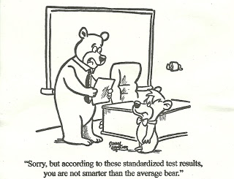
Notes:
Because you might be feeling like this after this presentation…we have created a booklet that contains all of the Need to Know Information for your reference.

Slide 6
Critical Iowa Assessment Information Booklet
Booklet that contains all critical, need to know information
Table of Contents formatted in sections including training & contact information and before, during, & after testing information
assessment.dmschool.org
Notes:
Booklet is formatted in sections-Before, During, and After testing
It has hyperlinks embedded for each document in the table of contents to use if this booklet is saved electronically.

Slide 7
Quick Access to Information Pages 3-4
Responsibilities for Building Administrators, Testing Coordinators, and Test Administrators
Training Presentation dates
Important dates
Contact information
Notes:
List of responsibilities by roles
Training dates based on how familiar you are with administering the Iowa Assessments

Slide 8
Before Testing
Notes:
Let’s start with the section “Before Testing”

Slide 9
Administration Requirements
Please read pages 5-6 and pay close attention to the requirements.
Please choose an area in which you feel you will need the most support.

Slide 10
Notes:
Poll Title: In which area will you need the most support? http://www.polleverywhere.com/free_text_polls/Q10p9ql4X9poQBc

Slide 11
Test Security Guidelines
Who is responsible?
Everyone is responsible!
The building principal is ultimately responsible.
At what times are we responsible?
At ALL times!
When you receive, store, distribute, test, package, and return testing materials!
Notes:
Principals have signed a Test Administration Assurance document from the Iowa Department of Education.

Slide 13
Report all incidents of unethical behavior by students or staff
Create documentation and deliver to Building Administrator
Building Administrator will pass along the report to the assessment department
Student’s tests results may be invalidated
Staff member shall be disciplined according to Iowa Code and Board Policy
Notes:
Document incidents and give to Administrator
If student is unethical, that student’s test results may not determined invalid
If staff member is unethical, disciplinary actions will be taken based on Iowa Code and Board Policy

Slide 14
Creating a Test Schedule
Determine:
accommodations that need to be provided to ELL, Special Education students, and students with a 504 plan
available test administrators
amount of time for each test including Try Out Items (20 minutes)
appropriate testing rooms
Notes:
Accommodations that must be provided
Test Administrators
Time for each test-Try Out Items
Appropriate testing rooms..

Slide 15
Testing Rooms
Adequate lighting
Students spaced far enough apart to prevent sharing of answers
Adequate writing surface for answer folder and open test booklet
No visual aids that would allow for an unfair advantage-if in doubt cover or remove
Notes:
Students are comfortable-light, heat, space for writing & spaced to discourage sharing of answers
Visual aids-if in doubt take them down or cover them up

Slide 16
Accommodations
Provided to students as documented on IEP or 504 Plan
English Language Learners participate in all tests except for
New ELL students (first year in the US) take ALL tests except the Reading
Consult with ELL and Special Education teachers regarding accommodations
Notes:
Pages 12-16 refer to Accommodations details

Slide 17
Notes:
Poll Title: Which of the following is not an accomodation? http://www.polleverywhere.com/multiple_choice_polls/Tr7HZvNNlvFUS7w

Slide 18
Do’s and Don’ts
Do document ELL accommodations by referring to Testing Accommodations with Codes document and send to the ELL department
Do follow recommended testing practices for ELL students
Do ensure that all students with documented accommodations actually receive these accommodations
Do use the documents available on the Assessment Site to support the teachers administering the tests
Notes:
These checklists are separate in this booklet but are combined in the document on the Weebly to save paper

Slide 19
Do’s and Don’ts
Don’t read the reading comprehension test passages, questions, or answers to anyone
Don’t provide dictionaries with definitions
Don’t translate questions and answers
Don’t alert students to possible errors

Slide 20
Distributing Testing Materials
Bar code labels come separately from answer folders and test booklets
Bar code labels must be affixed to the answer folders
Need more bar code labels-email the Order Form for Addition Barcode Labels (p.27) to Cindy Slinger within the first 2 days of testing
Detailed instructions on page 17

Slide 21
Iowa Assessment Audit p. 19
To support test administration, identify needs for improvement, and standardize testing experience for students
Information will be used to improve training the following year
Building administrators will be notified if their building is randomly selected for the audit by email
Notes:
We will be conducting a Iowa Assessment Test Audit again this year
We used the information obtained last year to create this booklet and modify the training presentations

Slide 22
Parent Support on the Assessment Site
assessment.dmschools.org
Flyers available to distribute to parents a week before test administration (p.21)
Opt Out forms are available if parents request p. 22-23
Notes:
P 21 sample of flyer
P 22-23 Opt Out Form
Parent Flyers are available in ½ sheets for paper distribution and full sheets for electronic distribution

Slide 23
During Testing

Slide 24
Procedures for Handling Testing Irregularities and Emergencies p. 26
Student safety is the first concern
Test security must be maintained
Document details and send to the Building Administrator

Slide 25
Iowa Assessment Teacher Administration Guide
Sent out to teachers in Teacher email and
will be available on the Assessment Site

Slide 26
After Testing

Slide 27
Returning Materials
Email communication sign up sheet with time slots for returning answer folders, parking, maps, etc.
Post-testing Checklist for Test Coordinator document details how to organize answer folders (p. 30)
Submit a pick up request to Central Stores for test booklets
Store Directions for Administration manuals for use next year

Slide 28
Individual Student Performance Rewards
Please consider the diverse populations in our district if instituting a reward structure
If a student population is less likely to get the reward because of language, socio economic status, or ability, the reward structure should not be put into place because of discrimination issues
Notes:
Classroom reward structure

Slide 29
Questions?

Slide 30
Celebrations & Updates

Slide 31
Scholastic Reading & Math Inventory Winter Data

Slide 32
SRI Mid-Year % Basic and Above
+ 20 %

Slide 33
SRI Mean Lexile Score
- 14

Slide 34
SMI Mid-Year % Basic and Above

Slide 35
SMI Mean Quantile Score

Slide 36
SMI & SRI Data Considerations
+ or - 15% variance in data representations
The more data points, and longer we collect data, the more accurate we can be.
SRI
On average, we have tested 300 more students per grade level this year than last.
SMI
For Winter testing, the numbers were consistent from year to year.

Slide 37
Go Math!

Slide 38
Teaching with Go Math! Data
Brubaker Elementary uses Go Math to teach Unit 3!

Slide 39
+ Feedback: 2.5.14 District PLC
I am excited about the new math series and materials (137 teachers).
I am excited about Go Math PD this year and in the summer.
Go Math looks great for small groups.
Materials look organized.
Very excited to get Chapter One TE so early.
I am excited to try the technology part of Go Math.
I am excited for ready made math stations.
Go Math seems more rigorous.
Super excited about the routines and structures in Go Math!
I am glad it is inline with the Iowa Core.
I am glad about the problem solving and application. The CGI connection.

Slide 40
Go math: Framework for teaching

Slide 41
Go Math: Framework for Teaching
K
1
2
3
4
5
Notes:
I am going to start off today with providing you with the framework for teaching the Go Math Series.

Slide 42
Go Math: Framework for Teaching
K
1
2
2
Kindergarten, Grade 1, and Grade 2 are set up very similar.
Grade 3, Grade 4, and Grade 5 are set up very similar.
Kindergarten and Grade 5 have some unique pieces.
3
4
5
Notes:
It is important to note that overall – Kindergarten, 1st and 2nd are set up very similar and Grade 3-5 are also set up very similar.
Then if you were to look closely you would see that Kindergarten has some unique pieces – as kindergarten itself is unique – as well as – 5th grade – really starting to prepare them for middle school.
Click
Our focus today is going to be 2nd grade. We did ask that everyone bring a copy of the 2nd grade Teacher’s Edition, but if you do not have one you can access the guide by going to the math website.

Slide 43
Go Math: Framework for Teaching
http://elementarymath.dmschools.org
Notes:
Anything that I overview with you today is available on the math webpage. I will give you a minute or two to pull up this website!

Slide 44
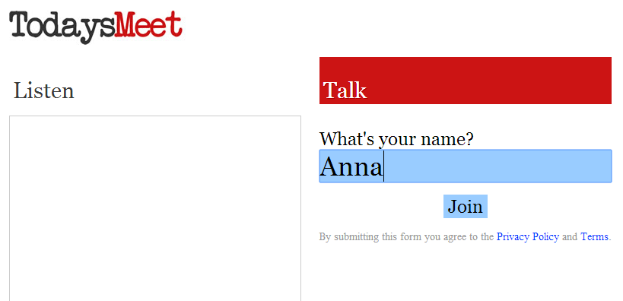
Go Math: Framework for Teaching
https://todaysmeet.com/gomath
Notes:
Anything that I overview with you today is available on the math webpage. I will give you a minute or two to pull up this website!
Since we do have a lot of information to share today – I do want to have a virtual parking lot available for questions and or comments. Even if it is something you see that you like – go ahead and share. We will have time for questions throughout the presentation today as well.
I find it so helpful in the PLC meetings to receive the teacher’s feedback and that really helps me plan for my next presentations. So anything you have questions or wonderings about – please do not hesitate to type it in.
Again, I am sharing everything I know to this point – but your questions help when I am talking with Houghton Mifflin and planning ahead. We are literally talking with HM daily and asking for more and more.
It sounds like more information and resources are going to be available in mid-April. I will continue the work with the new resources.
We will also be sharing this information at the PLC sessions for the rest of the year – so teachers will receive the message that way as well.

Slide 45
Common Questions: 2.5.14 District PLC
We are currently providing DMPS staff with the most up-to-date information in regards to Go Math.
We know there are many other common questions in regards to materials, PD, assessments, technology, Intervention, and SPED.
What will be provided throughout this presentation are yellow boxes with common questions that were asked during the 2.5.14 District PLC session. Answers and plans for these areas will be provided in the remaining District PLC sessions, as well as, Summer Training.
We appreciate your feedback and questions and will do our best to provide you with information as we have access to it and can deliver it in an organized manner.
Common Questions from 2.5.14 –
More information to come soon!
Assessments
Will there be unit pre + post tests given from the district or will we use Go Math?
Will pre-assessments be identical to the post assessments?
Materials
What type of manipulatives will we get? Will they align with the Go Math lessons?
What do we do with the consumable if a student moves?
Will the consumables be in color?
Common Questions from 2.5.14 –
More information to come soon!
The Math Block
Is 75 minutes really enough time for all components?
Will time be built into the pacing for re-teaching?
How does DMR/Mental Math fit into the schedule?
Why are we keeping DMR?
What will the non-negotiables be?
How much time will be spent on whole group, small group, and intervention?
Common Questions from 2.5.14 –
More information to come soon!
Intervention + SPED Support
Can we receive more information about tiers of interventions for teachers, interventionists, and SPED?
Will interventionists, title teachers, SPED teachers receive materials?
Are the tiered interventions in the book or somewhere else?
Will SPED have access to lower grade levels to meet the students’ ability levels
Common Questions from 2.5.14 –
More information to come soon!
Technology
What technology devices will we get?
Can students use the technology at home?
Is the bandwidth for the district going to support the increase in technology?
Is it like Think Central for Journeys?
More information on the technology components.
Notes:
We are currently providing DMPS staff with the most up-to-date information in regards to Go Math.
We know there are many other common questions in regards to materials, PD, assessments, technology, Intervention, and SPED.
What will be provided throughout this presentation are yellow boxes with common questions that were asked during the 2.5.14 District PLC session. Answers and plans for these areas will be provided in the remaining District PLC sessions, as well as, Summer Training.
We appreciate your feedback and questions and will do our best to provide you with information as we have access to it and can deliver it in an organized manner.
CLICK
An example of the yellow boxes you will see. At the last PLC many teachers had questions about assessments. We are thinking through and planning assessments and will deliver the information to you as soon as we possibly can. But do know we are working on it.

Slide 46
Go Math: District PLC
3.5.14 District PLC
Today we will…
Become familiar with the set-up of Chapter One in the Teacher’s Edition of Go Math.
Review the new Curriculum Guide format.
Use the Planning Guide to identify the components in a Go Math lesson.
4.16.14 District PLC
Next time we will…
Walk through the Framework for Teaching Elementary Math with Go Math .
Discuss differentiation and small group instruction supports.
May District PLC + Summer Training
Looking forward we will…
Assessments + Pacing
Technology
Notes:
PLCs at a glance….

Slide 47
Go Math: Framework for Teaching
Notes:
You have a document that looks like this in front of you. I am going to walk you through what does a math block look like in 2014 – 2015 in Des Moines Public Schools.
I know this is a document that a lot of teachers and leaders have been wanting for quite some time because they want to know how to structure our math time.
And then the question is raised – why do our math blocks across the district need to be consistent?
And the answer is that we have to maintain a level of consistency for our students in the district. We have 38 elementary schools and 1 and 4 students will be in a different math classroom at the end of the school year with a different teacher .

Slide 48
Go Math: Framework for Teaching
Notes:
This is an example of one of DMPS students. We all know these students who generally switch schools at least once a year. This gal could have had 8 different math teachers by 3rd grade. We want to determine a level of consistency for our students.

Slide 49
Go Math: Framework for Teaching
A Framework for Beginning our Implementation of the Go Math Materials
This instructional sequence to serve as a support for weekly planning when it feels as though “we can’t get it all in!”
Adjustments in regards to pacing and timing may be needed to meet the needs of students.
This should be considered a starting point as we work to become more efficient with the Go Math materials.
Notes:
Taking you through the introduction to the framework…
This instructional sequence to serve as a support for weekly planning when it feels as though “we can’t get it all in!”
Adjustments in regards to pacing and timing may be needed to meet the needs of students.
This should be considered a starting point as we work to become more efficient with the Go Math materials.

Slide 50
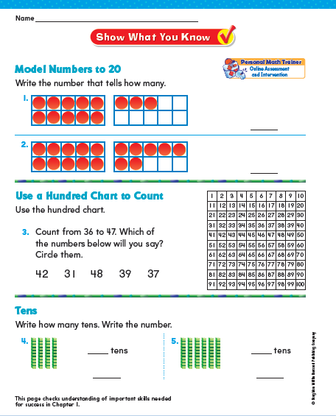
Go Math: Framework for Teaching
Tier 2 + 3 Students for Chapter 1
Notes:
Let’s talk briefly about how all classrooms will begin a chapter. I will touch on this a little more again later.
Prior to beginning a chapter (whether that is weeks before or days before) the teacher will start by doing a Pre-requisite Activity with the entire class. It does say Tier 2 on it – but we will do it with the whole group in order to jog the students memory of the pre-requisite skills so we are not sending them into a pre-assessment cold turkey.
Then the students will take this pre-assessment that is in every TE and SE. It is called “Show What You Know”. This will replace the district level pre-assessments.
It will decipher which students are going to need Tier 2 and Tier 3 support for this Chapter.
So for instance if all students take this assessments I may have 4 students who fall into the Tier 2 and Tier 3 section. Remember that I have outlined the 4 kiddos in red – you will see them again a little later.
Possible Questions:
What are district assessments going to look like next year?
We are still looking to iron out the assessment process for Go Math in our district next year. The curriculum guide team met two weeks ago to decide on chapter pacing and assessment ideas to best fit our needs. We will be able to finalize our assessment plan once we receive the newer editions in April. We will be able to share more information assessments and pacing in the May Teaching and Learning.
So pre- and post- assessments will be different next year – how will we show growth?
Yes the pre- and post- will be different. We are working on the assessment plan, but a lot of it will depend on what is included in the new edition. We do know that the Show What You Know will be the chapter Pre-Assessment. More information in May about the assessments and pacing and how it will work with the data teaming process.
We usually choose our Tier 2 and Tier 3 students based on an alternate assessment and hone in on a skill (basic facts) for six weeks at a time. Can we still do it that way? Why do it by chapter? Seems to short to make a difference.
We are going to use the Show What You Know because it is a test of the pre-requisite skills for concepts in that Chapter. If we take them out for six weeks and work on a different skill – they will be missing the interventions at their specific grade level – to which they are still responsible for learning. We are welcoming all feedback as we go through the implementation of this program this first year.

Slide 51
Go Math: Framework for Teaching
Math Block: 75 – 90 minutes/day
Daily Math Review +
Mental Math
(15 min maximum)
We will be providing DMR modification suggestions for teachers in order to adjust the time to fit 15 minutes without changing the purpose and integrity of DMR.
Notes:
Next year the elementary math block will be 75-90 minutes in length. This is a change from this year as the requirement was 60 – 90 minutes. I know many schools already have the 90 minutes – so if that is your school – please try to keep it at 90 minutes as it will be a tight schedule for teachers with 75 minutes.
The first component of the Math Block is Daily Math Review and Mental Math.
Teachers really appreciate this time with their students because it allows for them to review concepts that students may have no mastered in previous chapters and/or prerequisite skills for what is to come in future chapters.
It is the answer to the question, “What do I do if my students did not get the concept in the last chapter, but I have to move on?”
The difference this year is that DMR will have a time limit of 15 minutes. Go Math has many components and so we will need to make sure that DMR is not lasting longer than the 15 minutes otherwise it will not be possible to complete the rest of the math block components.
We will be providing DMR modification suggestions for teachers in order to adjust the time to fit 15 minutes without changing the purpose and integrity of DMR.
It is also important to remember that DMR is not a time where teachers will be “teaching” new concepts or reviewing word problems.

Slide 52
Go Math: Framework for Teaching
Math Block: 75 – 90 minutes/day
Daily Math Review +
Mental Math
(15 min maximum)
Whole Group Concept Development
(20 min)
ENGAGE
EXPLORE
EXPLAIN
Notes:
The next component in the math block will be WHOLE GROUP CONCEPT DEVELOPMENT.
Click
The first part of whole group concept development is called ENGAGE. The engage lesson really introduces the lesson before the students open their student editions. This part of the lesson is digital. We have not had a chance to preview the new versions of these, but we have talked to their program coordinator and she says this is a very cool, important part of the lesson – in order to get the students interested and invested in the content.
CLICK
The next part of whole group concept development is called EXPLORE. This is the whole group instruction piece where they are really learning the concept of the day. A lot of times you will see the Hands On symbol which means the students are using hands-on manipulatives to learn the concept. That being said, the teacher could be using the iTools and having students use the iTools on tablets.
K-2 Listen and Draw
3-5 Unlock the Problem
CLICK
The last part of whole group concept development is the EXPLAIN section. This is a guided practice section where the students complete some questions similar to the concept learned in the EXPLORE section. They call this Share and Show.

Slide 53
Go Math: Framework for Teaching
Math Block: 75 – 90 minutes/day
Daily Math Review +
Mental Math
(15 min maximum)
Whole Group Concept Development
(20 min)
Differentiated Instruction
(20 min)
FORMATIVE ASSESSMENT
EXPLAIN
Students needing additional support with lesson concept
Notes:
The Share and Show section or EXPLAIN has a Quick Check
Click
Which becomes the Formative Assessment in the middle of the lesson
It is 2 problems that the teacher is going to check for whether the students get that concept of the lesson. Chances are that most of the students will understand the concept of the day after going through 20 minutes of the whole concept development, but there may be a few that need some extra guidance from the teacher.
Click
This will lead us into the Differentiated Instruction lesson component.
Click
So after I check those two problems I may have 2 students who need additional support with lesson concept. Remember these 2 kiddos – as you will see them again soon too.
POSSIBLE QUESTIONS:
What if more than half the class does not pass the quick check?
Then the teacher is going to do some reteaching with that half of the class – we will talk a little about how that can look.
What is a quick way to check the quick check so it does not take time away from instruction?
We will be providing teachers with some management ideas to support the quick transitions needed for all the components to be covered each day. We do have several ideas that will be shared with teachers during the Summer PD.

Slide 54
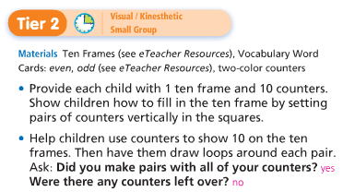
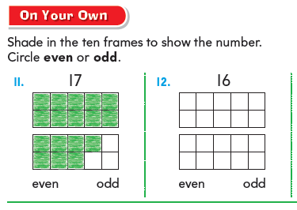
Go Math: Framework for Teaching
Differentiated Instruction
Small Group Instruction
3 – 5x per week
Independent/ Collaborative Work
Support Staff Push in During this Time
Notes:
So we are in the differentiated instruction part of the lesson.
Click
Most days we will split our classes into 2 groups of students:
Students needing additional support and proficient/advanced students
Let’s focus on our students needing additional support first…
How did I decide on these six kids?
The first four are the ones I identified as Tier2/Tier3 kids on the Show What You Know Assessment
The last two are the two I identified in my Quick Check as needing more support with this specific lesson concept
Those two kids will not stay the same each day because it is different lesson each day and a separate quick check. So some days you could only have 6 in your group, but there may be other days where this group is larger. The four Tier2/Tier3 students will most likely always be in this group.
Possible Question: What if the Tier2/Tier3 students passed the Quick Check?
That is going to be a teacher decision.
CLICK
So all of those students identified as needing additional support will complete a 10 minute Tier 2 activity with the teacher. It is the same concept of the day – but taught in a different, more scaffolded way.
Remembering that this part of the math block is 20 minutes – the teacher leads the entire group through the Tier 2 activity and then the group splits apart.
CLICK
The four Tier2/Tier3 kids will move into Personal Math Trainer on a tablet. Personal Math Trainer is a program that will help the students to practice the concept of the day, but personalize to their learning level. These students will use this for the last 10 minutes of this block daily.
CLICK
The two other students will do the On Your Own section in their student editions with the guidance of their teacher.
CLICK This small group instruction will occur 3-5x per week.
CLICK
The question always occurs – what is the rest of the class doing while those six kids are working with the teacher? And I know I only have 22 students represented up here and many of you have much larger classes. ☺
These students are doing independent/collaborative work.
CLICK
All of these students will complete teacher selected problems in the On Your Own section in their SE.
Click
After they complete that section they will move into Math Centers which could include – Grab and Go Differentiated Centers Kit, Technology, Math Journaling, and/or Fastt Math.
CLICK
This is the time in the lesson where push-in support will come in. So there actually be more than two groups going if teachers have the extra support available.
POSSIBLE QUESTIONS:
If we have push-in support – will they replace the personal math trainer in working with the students?
What about SPED? When do they get extra math support?
What if I do not have enough devices for Personal Math Trainer? More than six Tier2/Tier3?
Is Personal Math Trainer available for all students?
I do FASTT Math during small group time now. What is the expectation next year? Where does it fit in? If the students are on the devices for Personal Math Trainer when do the rest of the students do FASTT Math?
Tell me more about Personal Math Trainer. How is it personalized for that chapter and student?

Slide 55
Go Math: Framework for Teaching
Differentiated Instruction
Support Staff Push in During this Time
Personalized Learning
Independent/ Collaborative Work
Small Group Instruction
(1-2x per week)
Notes:
The Differentiated Instruction will look different at least 1 time per week.
It is important that we are also meeting with our advanced learners.
CLICK
So therefore, we may have three different groups: Advanced, Proficient, and Students Needing Additional Support.
CLICK
1-2 times per week the teacher will do a small group with those Advanced Students.
CLICK
There is an activity provided for them in the TE.
CLICK
The proficient students will be completing selected problems in the On Your Own section and then moving into centers.
CLICK
The students needing additional support will be using the PMT for the full 20 minutes.
CLICK
This is again when push-in support will be in the room if possible which could allow for more small groups to have contact with at teacher.
Possible Questions:
When do proficient students have time with the teacher in small group? If I always pass my quick check, but I am not necessarily advanced – when do I get time with the teacher?

Slide 56
Go Math: Framework for Teaching
Personal Math Trainer
Dynamic items + assignments to give your students unlimited practices on key concepts supported by guided examples, step-by-step solutions, and video tutorials.
Generates reports for teachers so instruction can be tailored to meet the students’ needs.
PMT will automatically prescribe and create standards-based, personalized interventions for the students.
Notes:
Taking you through the introduction to the framework…
This instructional sequence to serve as a support for weekly planning when it feels as though “we can’t get it all in!”
Adjustments in regards to pacing and timing may be needed to meet the needs of students.
This should be considered a starting point as we work to become more efficient with the Go Math materials.

Slide 57
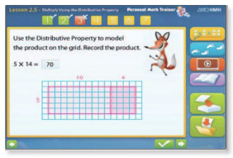
Go Math: Framework for Teaching
Personal Math Trainer
PMT targets each students’ individual needs and provides content support up to two grade levels below the current grade level.
PMT analyzes each student’s personal strengths, weaknesses, preferences, and learning pace.
The systems adaptive data structure provides real-time recommendations and strategies based on individual needs, challenges, and learning styles.
Notes:
Taking you through the introduction to the framework…
This instructional sequence to serve as a support for weekly planning when it feels as though “we can’t get it all in!”
Adjustments in regards to pacing and timing may be needed to meet the needs of students.
This should be considered a starting point as we work to become more efficient with the Go Math materials.

Slide 58
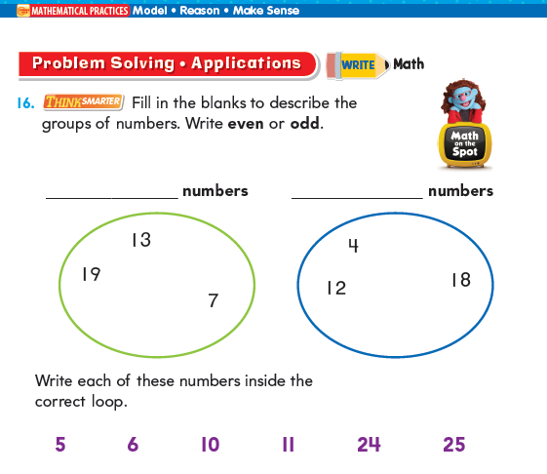
Go Math: Framework for Teaching
Math Block: 75 – 90 minutes/day
Daily Math Review +
Mental Math
(15 min maximum)
Whole Group Concept Development
(20 min)
Differentiated Instruction
(20 min)
Problem
Solving
(15 min)
Notes:
The last part of the math block is the problem solving section.
This section is timed at a 15 minute minimum. We recognize the importance of students solving problems in context and do not want to short change this section because it is at the end of a lesson.
Therefore, when teachers are planning lessons – they must plan for 15 minutes of problem solving daily and if they need to shorten other sections to do so – that is okay.
CLICK
The students have the problems in their SE and there are also videos available called Math On The Spot which are puppets leading students through how to solve certain problems.
The teachers will be using Interactive Whiteboard Lessons for the problem solving section.
POSSIBLE QUESTIONS: Interactive White Boards – will we have them? When? Will we be trained?

Slide 59
Go Math: Framework for Teaching
Math Block: 75 – 90 minutes/day
Daily Math Review +
Mental Math
(15 min maximum)
Whole Group Concept Development
(20 min)
Differentiated Instruction
(20 min)
Problem
Solving
(15 min)
ENGAGE
Small Group Instruction
EXPLORE
Independent / Collaborative
EXPLAIN
Personalized Learning
Notes:
SO this is essentially what a teacher’s math block will look like daily.
There will be some flexibility in the chapter pacing in order to make a few lessons 2-day lessons to fit the students’ needs. In which case, the schedule of those two days would look differently.
POSSIBLE QUESTIONS:
Do we have the flexibility to move these components around to fit the needs of our master schedule?
Could we put Daily Math Review after Differentiated Instruction in order to give more time to SPED?
Can we split out Problem Solving from the block?
Does DMR have to be done with the whole block?
If we move Small Groups to the end of the block it will help with push-in support…
This is a lot to fit into 75 minutes – what support will be given to teachers in the area of time management?

Slide 60
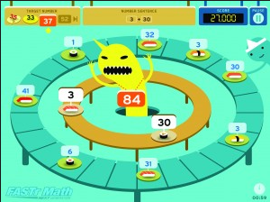
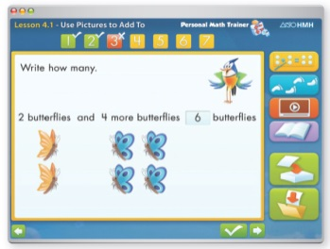
Go Math: Framework for Teaching
Math Block: 75 – 90 minutes/day
Daily Math Review +
Mental Math
(15 min maximum)
Whole Group Concept Development
(20 min)
Differentiated Instruction
(20 min)
Differentiated Instruction
(35-40 min)
Problem
Solving
(15 min)
Math Intervention: 15-20 minutes/day (**only for students in need of intensive support)
Tier 3 Small Group
Basic Fact Intervention
Notes:
I need help thinking through this section!

Slide 61
Go Math: Framework for Teaching
Notes:
Time to discuss
So that is all the information on this document. I am going to give you 5 minutes to talk this over with your team – and type questions/comments into Todays Meet.

Slide 62
Go math: chapter one + Curriculum guide

Slide 63
Go Math: Chapter One
Notes:
First page – Table of Content –
Lists Critical Area
Domains
All standards for the unit
This is really the overview for the whole chapter – teachers can see what they will be covering

Slide 64
Go Math: Chapter One
Critical Areas
Domain
Standard
Notes:
Just a reminder that this follows the language of the Iowa Core exactly.
Critical Areas are where students should be spending the majority of their instructional time. In 2nd grade there are 4 critical areas.
Domains such as Operations in Algebraic Thinking
And lastly, the Standard.

Slide 65
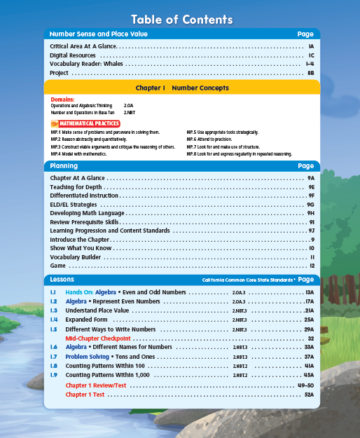
Go Math: Chapter One
Notes:
Second page – more in depth by lesson. It labels each lesson and aligns it with a Standard.

Slide 66
Go Math: Chapter One
Notes:
Overview pages…. These pages are not overly important.

Slide 67
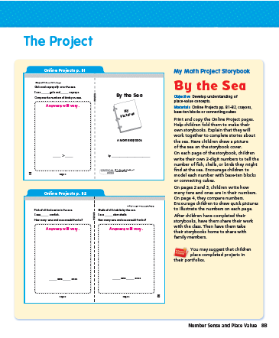
Go Math: Chapter One
Notes:
There are 3-4 Critical Area projects/readers provided. Every time a critical area is introduced – there is a new reader/project. We are not going to mandate these projects this year – but do know that these are available for teachers.

Slide 68
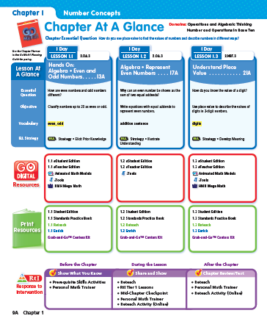
Go Math: Chapter One
Notes:
The next few pages are very helpful. They are called chapter at a glance.
It provides the teacher with the Chapter Essential Question as well as, the domains.
It also takes each lesson and breaks it down by how many days it will take, the essential question, the objective, the vocabulary, as well as the ELL strategy in that lesson.
It also lists the digital and print resources available.

Slide 69
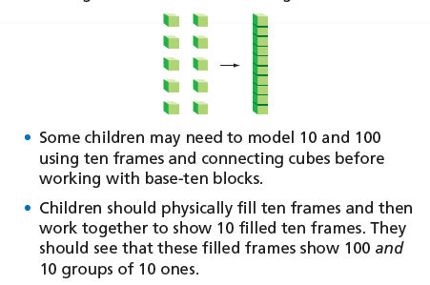
Go Math: Chapter One
Notes:
The next page is a professional development page for teachers.
We have identified that many teachers would like more support in the area of math content knowledge. This page will be worth spending time in planning and data teaming.
CLICK
It breaks down the concepts in the chapter and outlines what may be helpful in teaching students in various ways.
CLICK
It also outlines the mathematical practice standards.
Click
And provides PD videos to which teachers will be able to watch some of these strategies in action in a classroom.

Slide 70
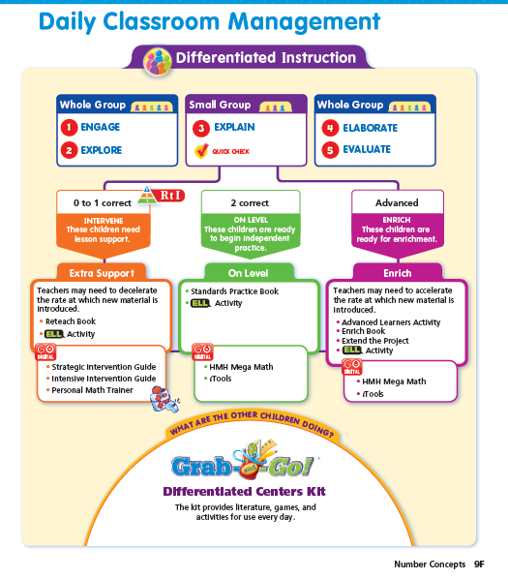
Go Math: Chapter One
Notes:
The next page outlines the classroom management – to which we have adjusted to fit DMPS – and that is what is outlined in the framework.

Slide 71
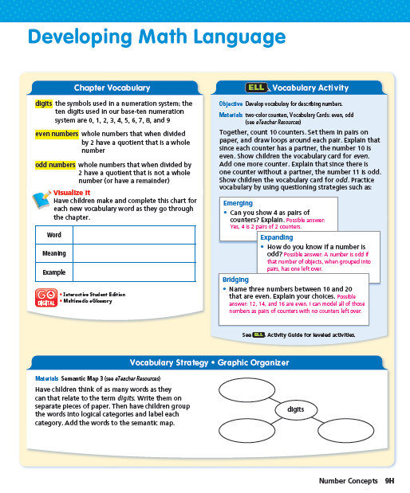
Go Math: Chapter One
Notes:
These next two pages focus on vocabulary – to which really is not mentioned a whole lot in the rest of the chapter. These will also be important pages in planning and data teaming – and not just for our ELL students, but all our struggling learners. We will spend time in these two pages in trainings as well.
I will actually come back to the Developing Math Language page in a bit because we will use this page at the start of every chapter with all students.

Slide 72
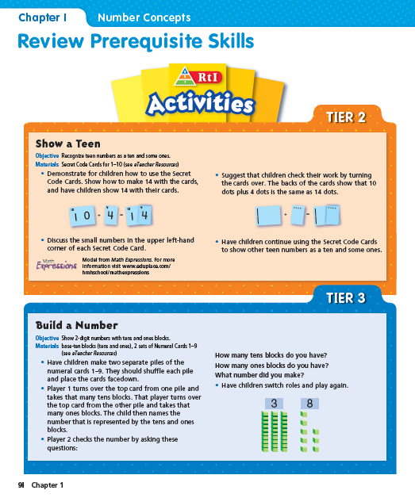
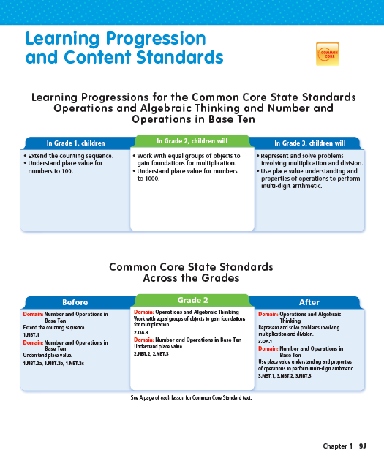
Go Math: Chapter One
Notes:
These next two pages are important and again will be utilized.
The first page gives the teacher two activities for students to review the prerequisite skills for the chapter.
The second page is similar to the page that we have currently have on our curriculum guides which outlines what the students learned in the previous grade level in relation to this concept – and will learn in the next grade level.

Slide 73
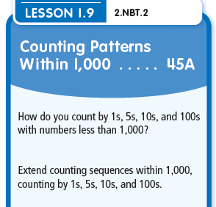
Go Math: Curriculum Guide
Notes:
So let’s take a look at what the new curriculum guide format will look like.
You should have a copy of this guide.
At the top of every grade you will see the grade level, the chapter number and the name of the chapter.
Then you see the chapter essential question to which is in CLICK the TE.
This first page does look very similar to our current guides – the difference is that the learner objectives have changed to match the objectives of the lesson.
CLICK
For example in lesson 1.9 the standard covered is CLICK NBT.2. And we have altered the I Can statement to match the objective of the lesson.

Slide 74
Go Math: Curriculum Guide
Notes:
You will also notice that the Before and After will be altered to match the Coherence page in the TE.

Slide 75
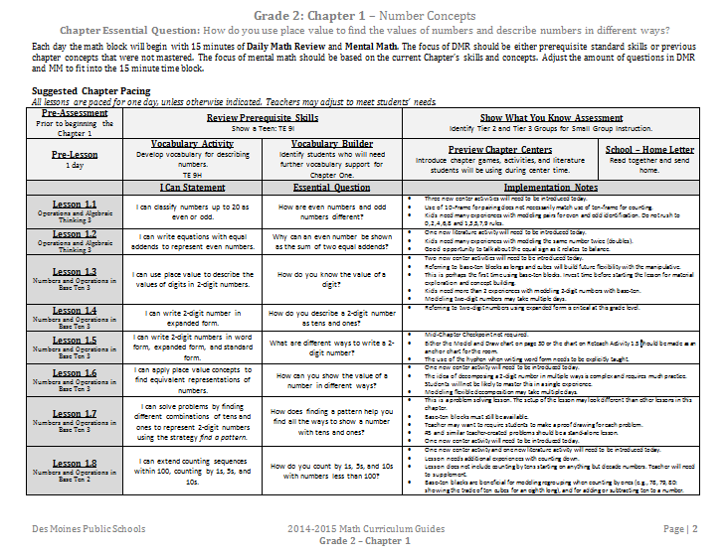
Go Math: Curriculum Guide
Notes:
The second page of the curriculum guide will walk teachers through the chapter and the expected outcomes.

Slide 76
Go Math: Curriculum Guide
Each day the math block will begin with 15 minutes of Daily Math Review and Mental Math. The focus of DMR should be either prerequisite standard skills or previous chapter concepts that were not mastered. The focus of mental math should be based on the current Chapter’s skills and concepts. Adjust the amount of questions in DMR and MM to fit into the 15 minute time block.
Daily Math Review +
Mental Math
(15 min maximum)
Notes:
The top of this page talks about DMR and Mental Math.

Slide 77
Go Math: Curriculum Guide
Suggested Chapter Pacing
All lessons are paced for one day, unless otherwise indicated. Teachers may adjust to meet students’ needs.
Go Math suggests…
1 lesson per day
1 day for introducing the Chapter
2 days for assessment
= 8 – 16 days per chapter
Go Math includes an average of 140 days of instruction/assessment
40 days remaining to add to chapters for differentiation and to meet the needs of our students.
Curriculum Guide Team will be working to block out Chapter pacing and the assessment calendar.
This work requires all 2015 TE Chapters.
More information to come on pacing, assessments, and how this work affects Data Teams.
Notes:
The next part discusses Chapter Pacing.
This is still in the very early stages of planning – as we need the new editions to really make decisions on pacing and assessments.
What we do know is what Go Math suggests…
They suggest 1 lesson per day, 1 day for introducing the chapter, 2 days for assessment – which depending on the number of lessons in a chapter equals out to anywhere from 8 – 16 days per chapter.
Go Math include an average of 140 days of instruction which would end our school year in the beginning of April.
That means that we have 40 days remaining to add to chapters for differentiation and to meet the needs of all of our students.
This will allow teachers to stretch a lesson over two day or bring in additional resources if needed.
A couple of weeks ago the curriculum guide writing team worked to block out chapter pacing and the assessment calendar. The conversations revolved around which concepts were a bit bigger and needed more instructional time.
In order to complete this work – we need to 2015 TE Chapters which we have been told will be delivered mid-April and then the team will resume their work and make modifications based on the new editions.
More information to come on pacing, assessments, and how this work affects Data Teams. I foresee being able to share more on this in May.

Slide 78
Go Math: Curriculum Guide
Notes:
So the start of the curriculum guide is what we discussed earlier.
Prior to the start of the chapter we start with reviewing the prerequisite skills with a whole group activity – as to not send them into the pre-assessment cold.
Then we do the Show What You Know pre-assessment which identifies our Tier 2 and Tier 3 students for the chapter.

Slide 79
Go Math: Curriculum Guide
Notes:
The TE does have a diagnostic assessment to help determine what intervention is needed for the students who miss certain problems on the assessment.

Slide 80
Go Math: Curriculum Guide
Notes:
This will help to identify students needing Tier 2 and Tier 3 support and what resources can be used to help these students.

Slide 81
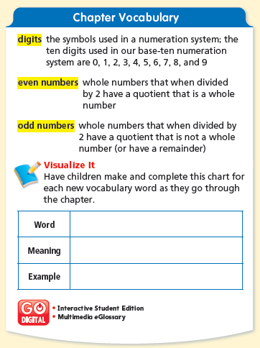
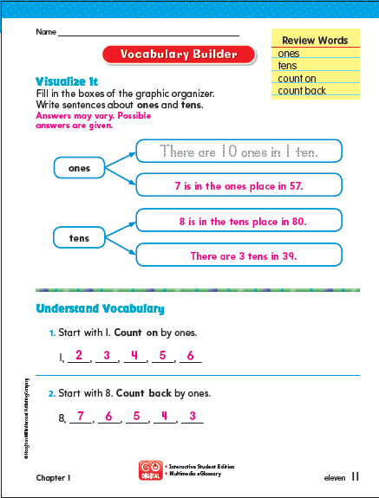
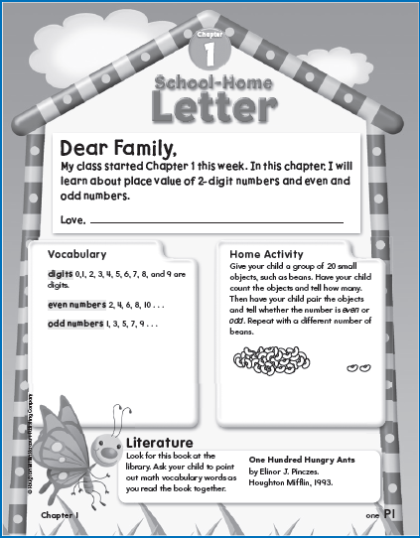
Go Math: Curriculum Guide
Notes:
The pre-assessment happens prior to starting the chapter.
The first day of the chapter will be an introduction day.
CLICK
First the teacher will do a vocabulary activity with the students. This is new vocabulary for the students and it often requires work with a graphic organizer.
The second activity will be completing the Vocabulary Builder that is in the student edition. This will help the teacher identify which students will need more support with language throughout the unit.
The third activity will be previewing what center activities and books will be available throughout the chapter.
And the last activity will be reading the School-Home Letter which communicates with families what the concept is of the chapter. Provides them with the vocabulary, an activity to do at home, and a book they can look for at their library. This letter will also be available electronically to be sent through infinite campus. It is also available in Spanish. The teacher will then send the letter home.

Slide 82
Go Math: Curriculum Guide
Notes:
The next part of the guide outlines what the outcomes of each lesson are.
For example – the I Can Statement is the learning objective of the lesson. This language is a little more mature and probably more suited for the teacher.
The second is the Essential Question of the lesson which is found under the ENGAGE section and also in the Student Edition. This is in Student friendly language. I have shown this presentation to some of our math coaches and a couple coaches said the essential question is a great writing to learn prompt every day.
The last section are the implementation notes for teachers – just things to consider when planning for instruction.

Slide 83
Go Math: Curriculum Guide
Notes:
Then the third page lists out the resources and centers that will be needed to teach the chapter. It lists out the technology, the hands-on resources, and the centers mentioned in the TE. I do plan to do some hyperlinking to these resources once they are available.
The last section is additional resources we have used in the past to teach these standards. They will be hyperlinked similar to how they are this year for easy access.

Slide 84
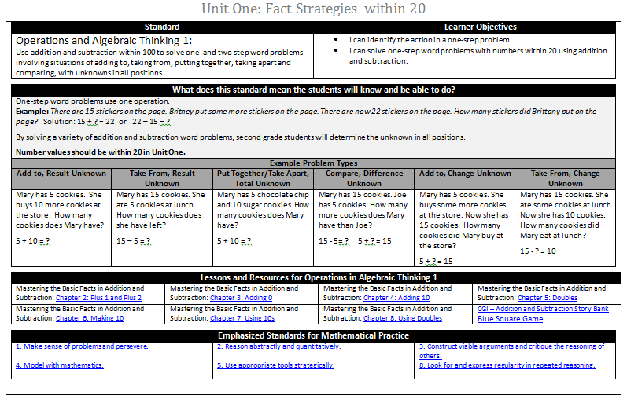
Go Math: Curriculum Guide
Similar to Common Core Lit Book: Used to strengthen teacher understanding of the Common Core Standards in Data Teams.
Notes:
The pages that are noticeably gone are these standards pages which explains in depth what each standard means.
My plan is to make a book of these for teachers – that just has all the standards for the grade level in one place – that way teachers and coaches can still utilize them in data teaming and planning.
So therefore you will notice our curriculum guides are considerably shorter – only three pages in length.

Slide 85
Go Math: Planning Guide
Planning Guides are available for Chapter One at each grade level only.
This will assist teachers in understanding the flow of lesson and a chapter.
Notes:
When I started creating the guides – I started with a planning guide template. It breaks down each of the components in a daily math lesson. If you were to flip through the teacher’s edition you would see that this is a bit redundant and unnecessary – but it is available for all Chapter Ones for all grade levels just to give teachers an idea on how to structure a lesson and a chapter.
So let’s break down what makes up a lesson.
The first is ENGAGE – which is the digital lesson. The engage lesson really introduces the lesson before the students open their student editions. This part of the lesson is digital. We have not had a chance to preview the new versions of these, but we have talked to their program coordinator and she says this is a very cool, important part of the lesson – in order to get the students interested and invested in the content.

Slide 86
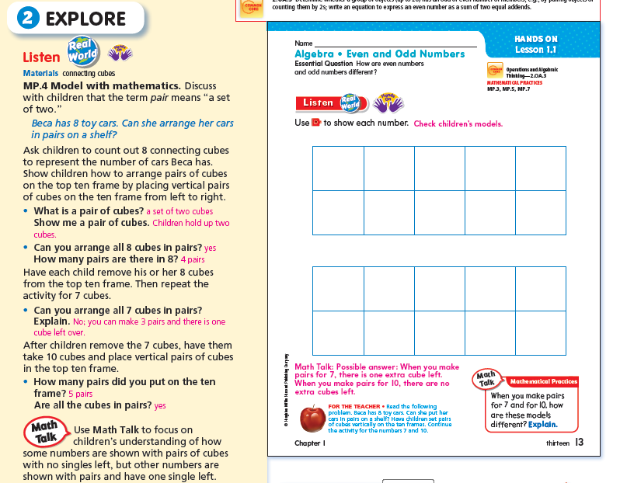
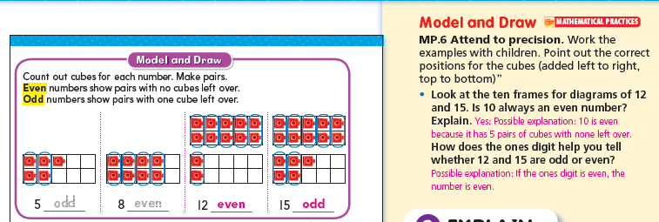
Go Math: Planning Guide
Notes:
The next part of the lesson is called EXPLORE. This is the whole group instruction piece where they are really learning the concept of the day. A lot of times you will see the Hands On symbol which means the students are using hands-on manipulatives to learn the concept. That being said, the teacher could be using the iTools and having students use the iTools on tablets.
K-2 Listen and Draw/Model and Draw
3-5 Unlock the Problem

Slide 87
Go Math: Planning Guide
Students needing additional support with lesson concept
Notes:
The next section is called EXPLAIN. This is a guided practice section where the students complete some questions similar to the concept learned in the EXPLORE section. They call this Share and Show.
The Share and Show section or EXPLAIN has a Quick Check
Which becomes the Formative Assessment in the middle of the lesson
It is 2 problems that the teacher is going to check for whether the students get that concept of the lesson. Chances are that most of the students will understand the concept of the day after going through 20 minutes of the whole concept development, but there may be a few that need some extra guidance from the teacher.

Slide 88
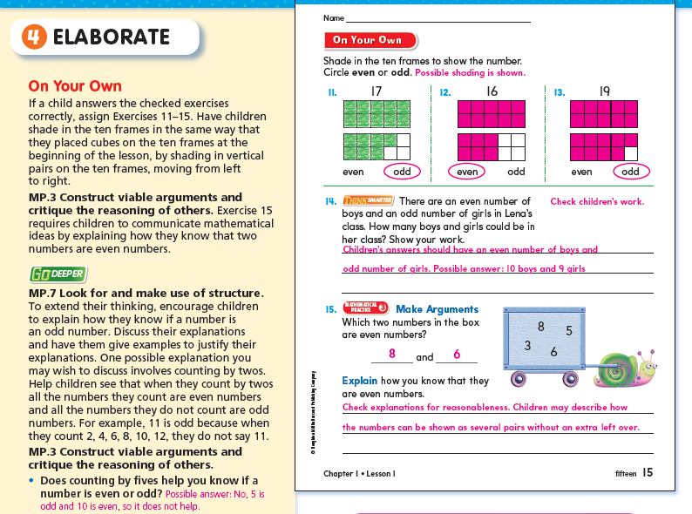
Go Math: Planning Guide
Notes:
The teacher will work with the students who did not pass the quick check while the rest of the students will complete the On Your Own section and then move into Math Centers.

Slide 89
Go Math: Framework for Teaching
Differentiated Instruction
Small Group Instruction
3 – 5x per week
Independent/ Collaborative Work
Support Staff Push in During this Time
Notes:
So we are in the differentiated instruction part of the lesson.
Click
Most days we will split our classes into 2 groups of students:
Students needing additional support and proficient/advanced students
Let’s focus on our students needing additional support first…
How did I decide on these six kids?
The first four are the ones I identified as Tier2/Tier3 kids on the Show What You Know Assessment
The last two are the two I identified in my Quick Check as needing more support with this specific lesson concept
Those two kids will not stay the same each day because it is different lesson each day and a separate quick check. So some days you could only have 6 in your group, but there may be other days where this group is larger. The four Tier2/Tier3 students will most likely always be in this group.
Possible Question: What if the Tier2/Tier3 students passed the Quick Check?
That is going to be a teacher decision.
CLICK
So all of those students identified as needing additional support will complete a 10 minute Tier 2 activity with the teacher. It is the same concept of the day – but taught in a different, more scaffolded way.
Remembering that this part of the math block is 20 minutes – the teacher leads the entire group through the Tier 2 activity and then the group splits apart.
CLICK
The four Tier2/Tier3 kids will move into Personal Math Trainer on a tablet. Personal Math Trainer is a program that will help the students to practice the concept of the day, but personalize to their learning level. These students will use this for the last 10 minutes of this block daily.
CLICK
The two other students will do the On Your Own section in their student editions with the guidance of their teacher.
CLICK This small group instruction will occur 3-5x per week.
CLICK
The question always occurs – what is the rest of the class doing while those six kids are working with the teacher? And I know I only have 22 students represented up here and many of you have much larger classes. ☺
These students are doing independent/collaborative work.
CLICK
All of these students will complete teacher selected problems in the On Your Own section in their SE.
Click
After they complete that section they will move into Math Centers which could include – Grab and Go Differentiated Centers Kit, Technology, Math Journaling, and/or Fastt Math.
CLICK
This is the time in the lesson where push-in support will come in. So there actually be more than two groups going if teachers have the extra support available.
POSSIBLE QUESTIONS:
If we have push-in support – will they replace the personal math trainer in working with the students?
What about SPED? When do they get extra math support?
What if I do not have enough devices for Personal Math Trainer? More than six Tier2/Tier3?
Is Personal Math Trainer available for all students?
I do FASTT Math during small group time now. What is the expectation next year? Where does it fit in? If the students are on the devices for Personal Math Trainer when do the rest of the students do FASTT Math?
Tell me more about Personal Math Trainer. How is it personalized for that chapter and student?

Slide 90
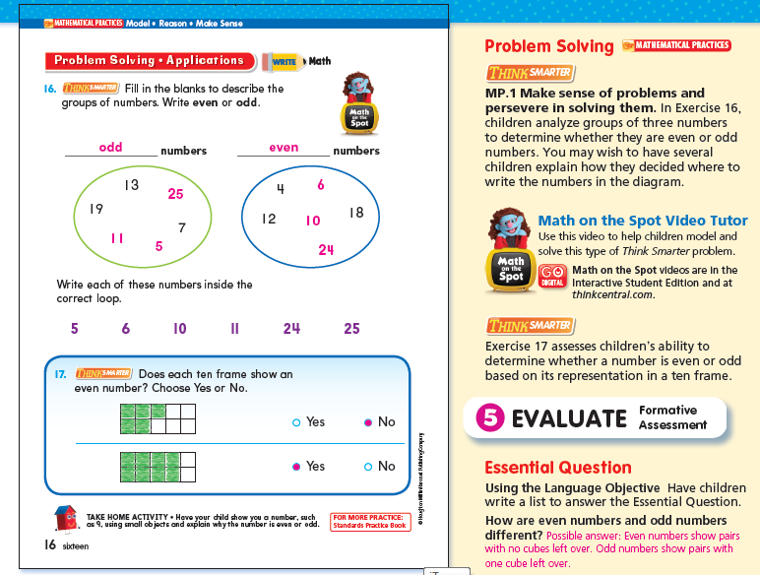
Go Math: Planning Guide
Notes:
The last component of a lesson is the problem solving section. The problem solving questions are tied closely to the mathematical practice standards. Students will be spending at least 15 minutes each day problem solving.

Slide 91
Break (15 Min)

Slide 92
Supporting Implementation

Slide 93
Questions from framework and chapter One

Slide 94
Go math: critical success factors

Slide 95
Go Math: Critical Success Factors
Critical Success Factors: Effective Implementation of Go Math
The Iowa Common Core Standards and the learner objectives listed on our district curriculum guides are our K-5 Mathematics curriculum.
The curriculum guides clearly articulate what students need to know and be able to do during each unit of study at each grade level.
The recently purchased Go Math is a comprehensive Mathematics program that supports the Common Core by emphasizing explicit, systematic instruction in the areas of conceptual understanding, application, and procedural skill and fluency.
This program will be used as our primary tool to support instruction and enhance students’ mastery of the Iowa Common Core Standards.
Notes:
Overview slide…

Slide 96
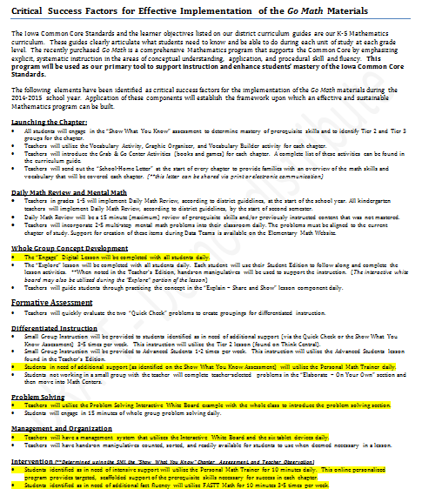
Go Math: Critical Success Factors
Notes:
Overview slide…

Slide 97
Go Math: Critical Success Factors
The following elements have been identified as critical success factors for the implementation of the Go Math materials during the 2014-2015 school year. Application of these components will establish the framework upon which an effective and sustainable Mathematics program can be built.
Notes:
Overview slide…

Slide 98
Go Math: Critical Success Factors
Launching the Chapter
Show What You Know Pre-Assessment
Vocabulary Activity
Vocabulary Builder
Grab and Go Centers
School-Home Letter
Notes:
All students will complete the show what you know prior to the start of the chapter to identify Tier 2 and 3 students. This will be the pre-assessment for the chapter.
The introduction of the chapter will include two activities surrounding the vocabulary in the chapter.
This is also an opportunity to introduce the centers that will be used for the chapter.
As well as review the school-home letter which can be accessed electronically.

Slide 99
Go Math: Critical Success Factors
Launching the Chapter
Daily Math Review + Mental Math
Show What You Know Pre-Assessment
Grade 1 – 5: beginning of school year
Vocabulary Activity
Grade K: start of second semester
Vocabulary Builder
15 minutes maximum
Grab and Go Centers
2-5 multi-step mental math problems daily
School-Home Letter

Slide 100
Go Math: Critical Success Factors
Launching the Chapter
Daily Math Review + Mental Math
Whole Group Concept Development
Show What You Know Pre-Assessment
Grade 1 – 5: beginning of school year
“Engage” Digital Lesson
Daily
Vocabulary Activity
Grade K: start of second semester
“Explore” Lesson Daily
Vocabulary Builder
Hands-on Manipulatives
15 minutes maximum
Grab and Go Centers
Guided Practice: “Explain” - Share and Show
2-5 multi-step mental math problems daily
School-Home Letter

Slide 101
Go Math: Critical Success Factors
Launching the Chapter
Daily Math Review + Mental Math
Whole Group Concept Development
Formative Assessment
Show What You Know Pre-Assessment
Grade 1 – 5: beginning of school year
“Engage” Digital Lesson
Daily
Quick Check: Create Groupings
Vocabulary Activity
Grade K: start of second semester
“Explore” Lesson Daily
Vocabulary Builder
Hands-on Manipulatives
15 minutes maximum
Grab and Go Centers
Guided Practice: “Explain” - Share and Show
2-5 multi-step mental math problems daily
School-Home Letter

Slide 102
Go Math: Critical Success Factors
Launching the Chapter
Daily Math Review + Mental Math
Whole Group Concept Development
Formative Assessment
Differentiated Instruction
Small Group Instruction 3-5x week for students in need of additional support.
Small Group Instruction 1-2x week for Advanced Students.
Students Needing Additional Support: Personal Math Tutor daily
Students not in small group will complete “On Your Own” and Math Centers.

Slide 103
Go Math: Critical Success Factors
Launching the Chapter
Daily Math Review + Mental Math
Whole Group Concept Development
Formative Assessment
Differentiated Instruction
Problem
Solving
Small Group Instruction 3-5x week for students in need of additional support.
Utilize Problem Solving Interactive White Board example
15 minutes minimum daily
Small Group Instruction 1-2x week for Advanced Students.
Students Needing Additional Support: Personal Math Tutor daily
Students not in small group will complete “On Your Own” and Math Centers.

Slide 104
Go Math: Critical Success Factors
Launching the Chapter
Daily Math Review + Mental Math
Whole Group Concept Development
Formative Assessment
Differentiated Instruction
Problem
Solving
Management + Organization
Small Group Instruction 3-5x week for students in need of additional support.
Utilize Problem Solving Interactive White Board example
Plan for differentiated instruction using Think Central Resources.
15 minutes minimum daily
Management system for use of technology.
Small Group Instruction 1-2x week for Advanced Students.
Organization of manipulatives
Students Needing Additional Support: Personal Math Tutor daily
Students not in small group will complete “On Your Own” and Math Centers.

Slide 105
Go Math: Critical Success Factors
Launching the Chapter
Daily Math Review + Mental Math
Whole Group Concept Development
Formative Assessment
Differentiated Instruction
Problem
Solving
Management + Organization
Intervention
Small Group Instruction 3-5x week for students in need of additional support.
Utilize Problem Solving Interactive White Board example
Plan for differentiated instruction using Think Central Resources.
Tier 3
Fastt Math
15 minutes minimum daily
Management system for use of technology.
Small Group Instruction 1-2x week for Advanced Students.
Organization of manipulatives
Students Needing Additional Support: Personal Math Tutor daily
Students not in small group will complete “On Your Own” and Math Centers.

Slide 106
Go Math: Critical Success Factors
Launching the Chapter
Daily Math Review + Mental Math
Whole Group Concept Development
Formative Assessment
Differentiated Instruction
Problem
Solving
Management + Organization
Intervention
Questions?
Process Time

Slide 107
Professional development

Slide 108
Go Math: Spring 2014 District PLCs
3.5.14 District PLC
Become familiar with the set-up of Chapter One in the Teacher’s Edition of Go Math.
Review the new Curriculum Guide format.
Use the Planning Guide to identify the components in a Go Math lesson.
4.16.14 District PLC
Walk through the Framework for Teaching Elementary Math with Go Math .
Discuss differentiation and small group instruction supports.
May District PLC + Summer Training
Assessments + Pacing
Technology
Notes:
PLCs at a glance….

Slide 109
Go Math: Summer Training
Summer PD Agenda Overview
Teacher and Student Edition Exploration and Collaboration
Framework for Teaching and Critical Success Factors
Go Math Technology Components
Problem Solving Classroom Situations
Assessment and Pacing
Summer PD
1. Are there only 75 openings per grade level for summer training?
There will be 14 half day sessions available for teachers to attend which will allow for over 1,000 teachers to participate. We will monitor the numbers during registration and provide additional sessions if needed.
2. When are the sessions for summer training? Will there be both am and pm sessions?
The 14 sessions will be offered in June and August. More information on dates and registration to come. The sessions will be from 8:30am – 12:00pm or 12:30pm – 4:00pm.
Notes:
PLCs at a glance….

Slide 110
Go Math: 2014-2015 District PLCs
District PLCs
Current Chapter Exploration, Collaboration, and Planning
Assessments, Pacing, and Data Teams
Time Management in the Math Block
Go Math Technology
Building Content Knowledge – Using Go Math Resources
Technology + Manipulative Management and Organization
Problem Solving Classroom Situations
Grade Level Specific
Classroom Teacher Led
Notes:
PLCs at a glance….

Slide 111
Questions from Critical Success Factors and Professional Development

Slide 112
Next Steps…

Slide 113
Distribution Plan
We ordered printed copies of Chapter 1 for all core classroom teachers + 2 at each grade level.
These documents are also available on SharePoint if additional copies are needed.
Student Editions for Chapter 1 will be printed if delivery is not guaranteed by the 1st day of implementation.
Additional distribution information will be provided as we receive confirmation.

Slide 114
What will be ordered? (Physical Materials)
Core Classroom & Self-Contained Special Education Classrooms:
Teacher Edition
Student Edition (1 per student – consumable)
Math Boards (1 per student)
Differentiated Centers
Manipulative Kits (1 per student)
In-Class Interventionists (Title, ELL and Special Education)
Teacher Edition
Intervention Lesson Book

Slide 115
Removal of Materials
The option to remove your 2008 HM Reading Materials will be provided this spring. The procedures for this removal will be provided in next week’s CIA eBlast.
The removal of Math Expressions & Investigations will occur in October. Please do NOT initiate a transfer for these materials prior to October.

Slide 116
March T+L Agenda (**March 11th)
Continuation of Go Math! Implementation Information
Technology Integration
2014-2015 Science & Social Studies Information
Finalized Summer Professional Development Plan

Slide 117
Public Data Snapshot
T & L Meetings
February 2014

Slide 118
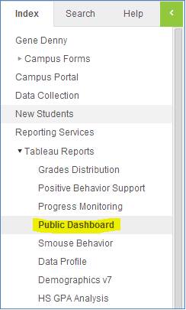
Accessing the Data Snapshot for Review
Infinite Campus: Once logging in, navigate to the following location on the Infinite Campus Outline. (Preferred method)
Web: http://tableau.dmps.k12.ia.us/views/PublicDashboard_022114/MapSplashScreen#4

Slide 119
Timeline
February 24 - March 6: Collect feedback from school leaders
March 6 - 11: Edit data snapshot according to feedback
March 12: Internal review of final data snapshot (link will be emailed to all school leaders)
March 17: Data snapshot posted to district website

Slide 120
Feedback
https://www.surveymonkey.com/s/datasnapshot

